Slide 1
Team CDK
Daniel Packer
Rafael Rodriguez
Sahat Yalkabov

Slide 2
TCR Signaling Pathway
TCR (T cell receptor)
  Molecule found on T Cells
  Response for recognizing antigens on MHC (Major Histocompatibility Complex)
T cell is activated when TCR engages with antigen

Slide 3
T cells
Belong to white blood cells group called lymphocytes
  Play central role in immunity
Distinguished from other cells by the presence of TCR on its surface
Named T cells because they mature in thymus

Slide 4
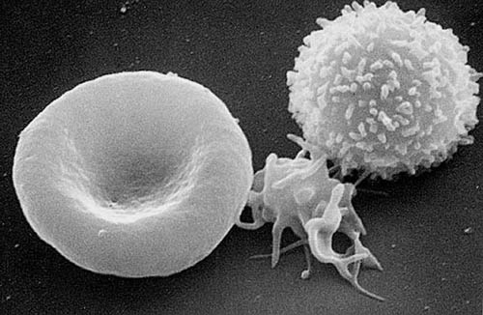
Electron micrograph of T cell

Slide 5
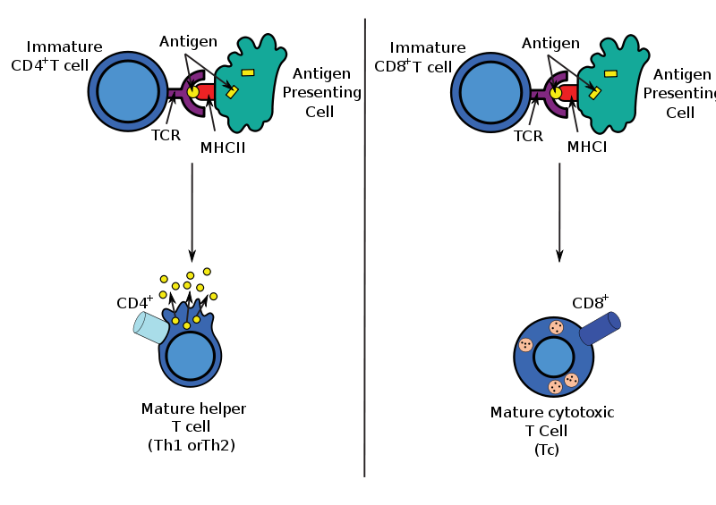
T cell formation

Slide 6
CD8+ and CD4+ T cells
CD8+ (Cytotoxic T cells)
  Destroy virally infected cells and tumor cells
  Transplant rejection
  Recognize targets by binding to antigens associated with MHC class I
    Present on ~99.9% of the cells in the body
  Deactivated to anergic (inactive) state with the help of molecules secreted by the T-reg cells
    To prevent autoimmune diseases

Slide 7
CD8+ and CD4+ T cells
CD4+ (Helper T cells)
  Assist white blood cells with immunologic processes, as well as activation of cytotoxic T cells
  Activates with peptide antigens from MHC class II molecules (pMHC)
    Expressed on the surface of APCs
  When activated, divide rapidly and secrete small proteins called cytokines
    Regulate or assist active immune response

Slide 8
MHC
Cell surface molecule
Mediate interactions between white blood cells and other immune cells or the body cells
Determines compatibility of organ transplants
Measures the susceptibility to autoimmune diseases
In humans, MHC also called HLA (human leukocyte antigen)
  MHC region occurs on chromosome 6

Slide 9
Structure of TCR
Member of immunoglobulin superfamily
Consists of 2 halves:
  Alpha/Beta and Gamma/Delta fragments
Structure similar to immunoglobulin Fab fragments

Slide 10
Generation of TCR 1/2
Alpha/Gamma chain - generated by VJ recombination
Beta/Delta chain – generated by V(D)J recombination
Intersection corresponds to CDR3 region
  Important for antigen-MHC recognition

Slide 11
Generation of TCR 2/2
Involves random joining of gene segments to complete TCR chain
Unique combinations of segments, as well as palindromic and random N- and P- nucleotide additions accounts for great diversity

Slide 12
T cell activation 1/2
TCR complex identifies specific bound antigen and elicits a distinct response
  The mechanism by which T cells evoke response is called T cell activation
The most common mechanism for activation is via phos./dephos. by proten kinases.
TCR associated reactions kinases:
  Lck
  Fyn
  CD45
  Zap70

Slide 13
T cell activation 2/2
pMHC(agonist)
  Interacts even at low concentrations
pMHC(endogenous)
  Weak interactions / No effect

Slide 14
Target molecule: ERK
Extracellular signal-regulated kinases
Involved in regulation of meiosis, mitosis, and postmitotic.
Activates on:
  Growth factors, cytokines, virus infection, transforming agents, carcinogens.

Slide 15
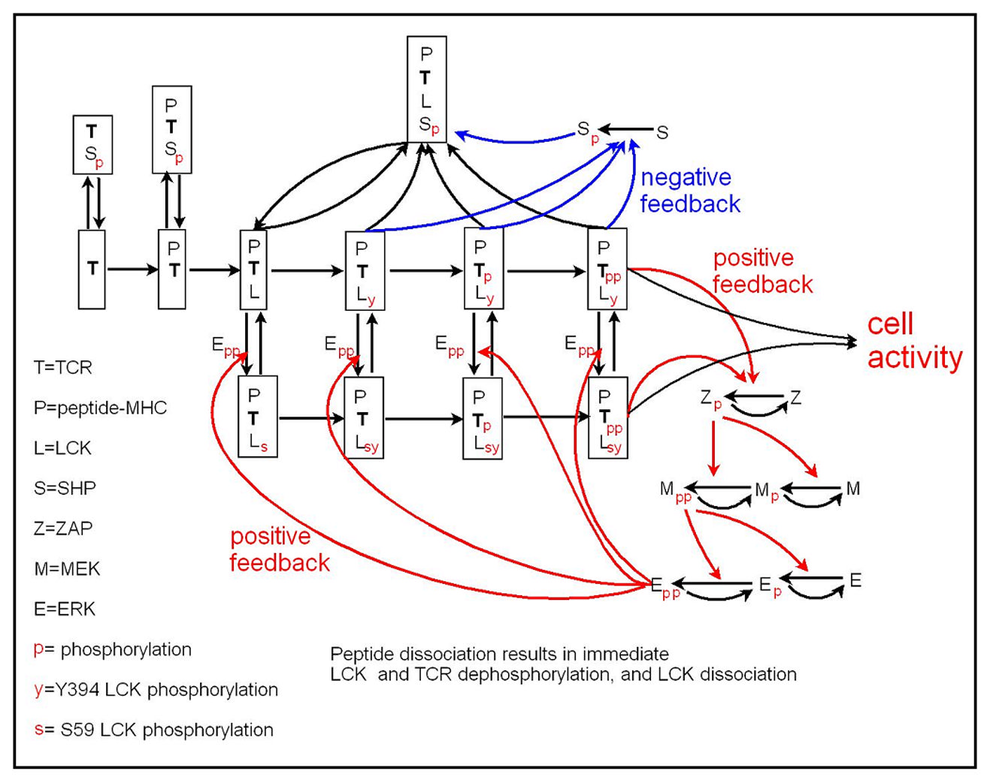

Slide 16
Results

Slide 17
Results

Slide 18
Results

Slide 19
Results

Slide 20
Results

Slide 21
Results

Slide 22
Conclusion
pMHC(endogenous) had little to no effect on the activation times of ERK
pMHC(agonist) had a very noticeable effect on the activation times of ERK
ERK concentration starts around 202,000 and tops out at 296,000
The activation times of ERK depend on pMHC(agonist) concentrations
  The greater pMHC concentration, quicker are the activation times and smaller the time distribution

