Slide 1
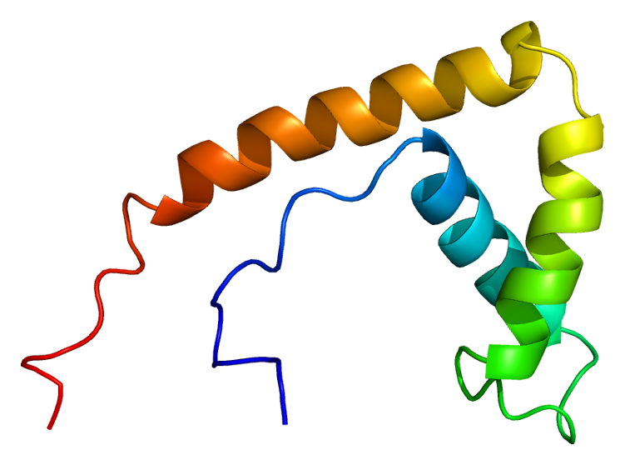
HMGB1 – RAGE – Cyclin E pathway
Jefry Lagrange
Stuart Weinberg
Daniel Zegel
CMACS Jan 2012
Cell Signaling Pathway Workshop – Pancreatic Cancer

Slide 2
The Characters and the Plot
Ligand – HMGB1
Receptor – RAGE (Receptor for Advanced Glycation End-Products)
Target – Cyclin E (CE)
The binding of HMGB1 to RAGE is known to initiate three major pathways: apoptosis, DNA repair, cell proliferation via admittance to S Phase.

Slide 3
The Plot thickens
HMGB1 is active as two forms:
a secreted cytokine
a nuclear non-histone transcription factor protein

Slide 4
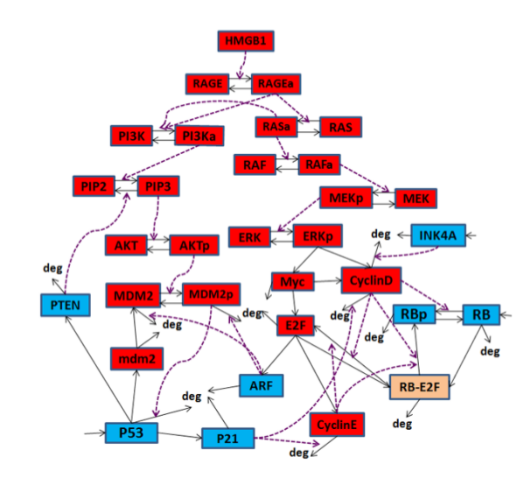
HMGB1 Pathway

Slide 5
Abstract of HMGB1 wire model

Slide 6
HMGB1 and RAGE is over-expressed in many cancers
Higher concentrations of HMGB1 with RAGE at 10⁵ (Cancer cell rate) - activation time is quickest.

Slide 7
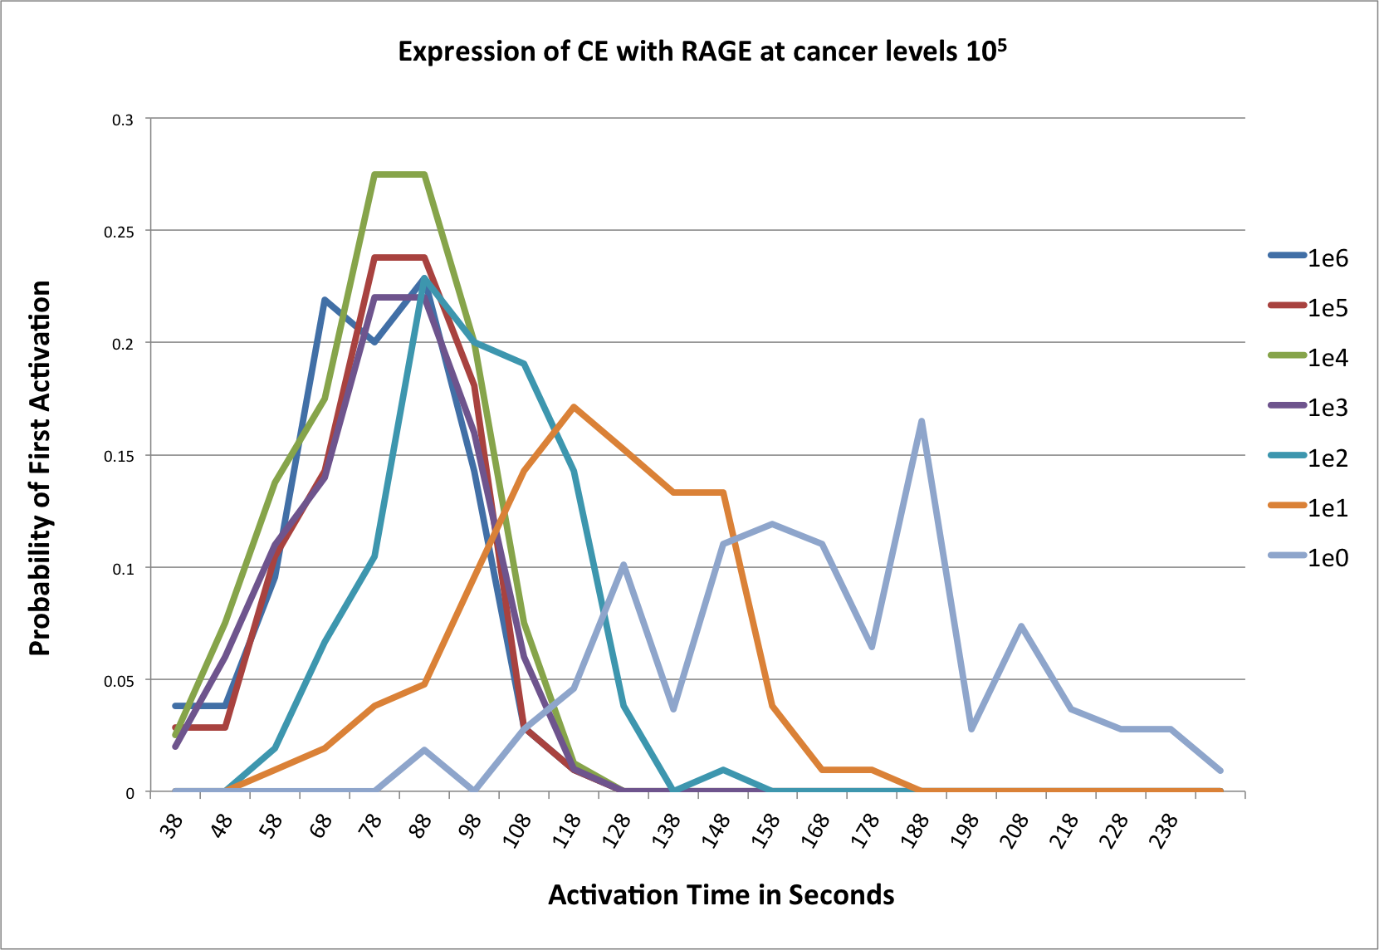
RAGE 10^{5 _} HMGB1 concentrations 1-10⁶

Slide 8
Observations
Earliest activation time approx 28 Seconds _ HMGB1 10⁶ highest probability
10⁴, 10³ concentrations follow, then 10⁵
However after several seconds 10⁴ & 10³ increase rapidly
Concentrations 10², 10¹, & 1 lag expectedly

Slide 9
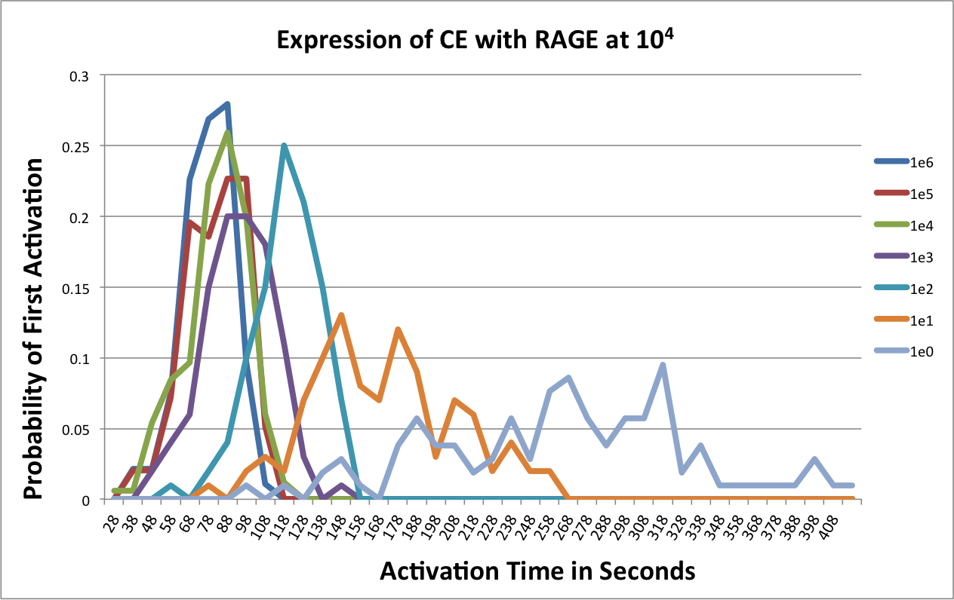
RAGE 10^{4 _} HMGB1 concentrations 1-10⁶

Slide 10
Observations
10⁴ earliest activation time at 28 sec but at a lower probability than at RAGE 10⁵
10⁶ & 10⁵ follow with the next highest probability
Around 88 seconds 10⁶ is the greatest chance of first CE activation

Slide 11
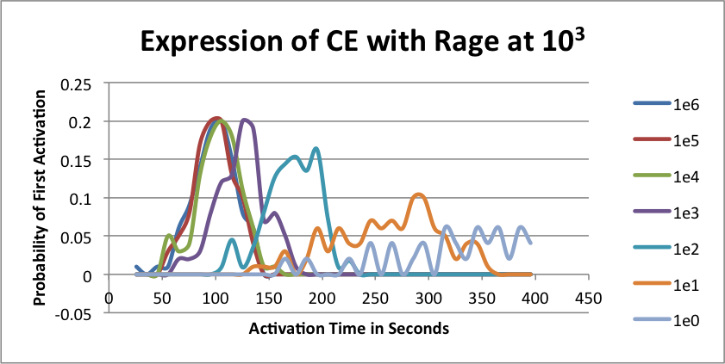
RAGE 10^{3 _} HMGB1 concentrations 1-10⁶

Slide 12
Conclusions
At RAGE 10³ – HMGB1 concentrations above 10³ saturate the receptor dropping off quickly
HMGB1 10³ activates CE next and also drops off

Slide 13
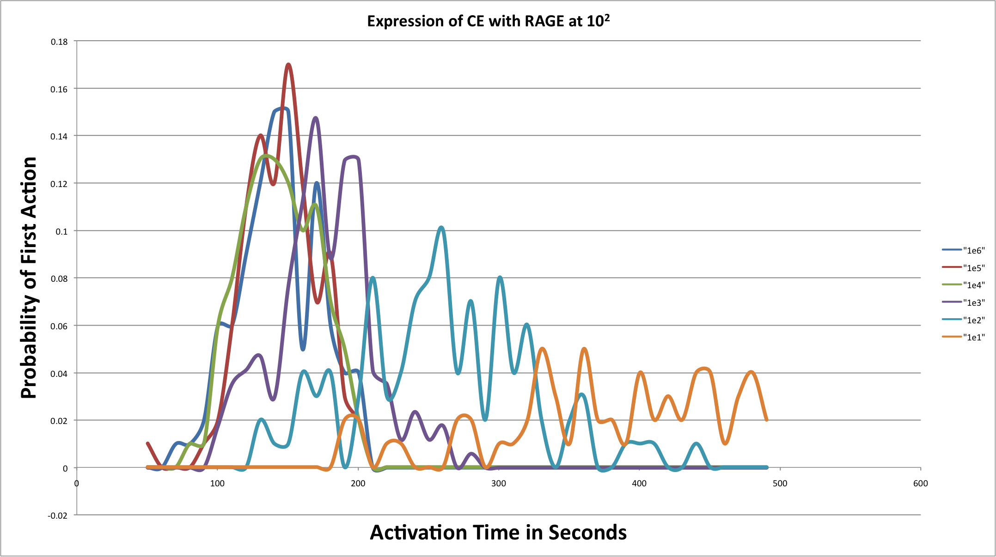
RAGE 10^{2 _} HMGB1 concentrations 1-10⁶

Slide 14
Observations
First activation most probable not until around 150 seconds
10⁵ first activation followed by 10⁶
10⁶ - 10³ most probable to start activating closer together as RAGE concentration is lowered

Slide 15
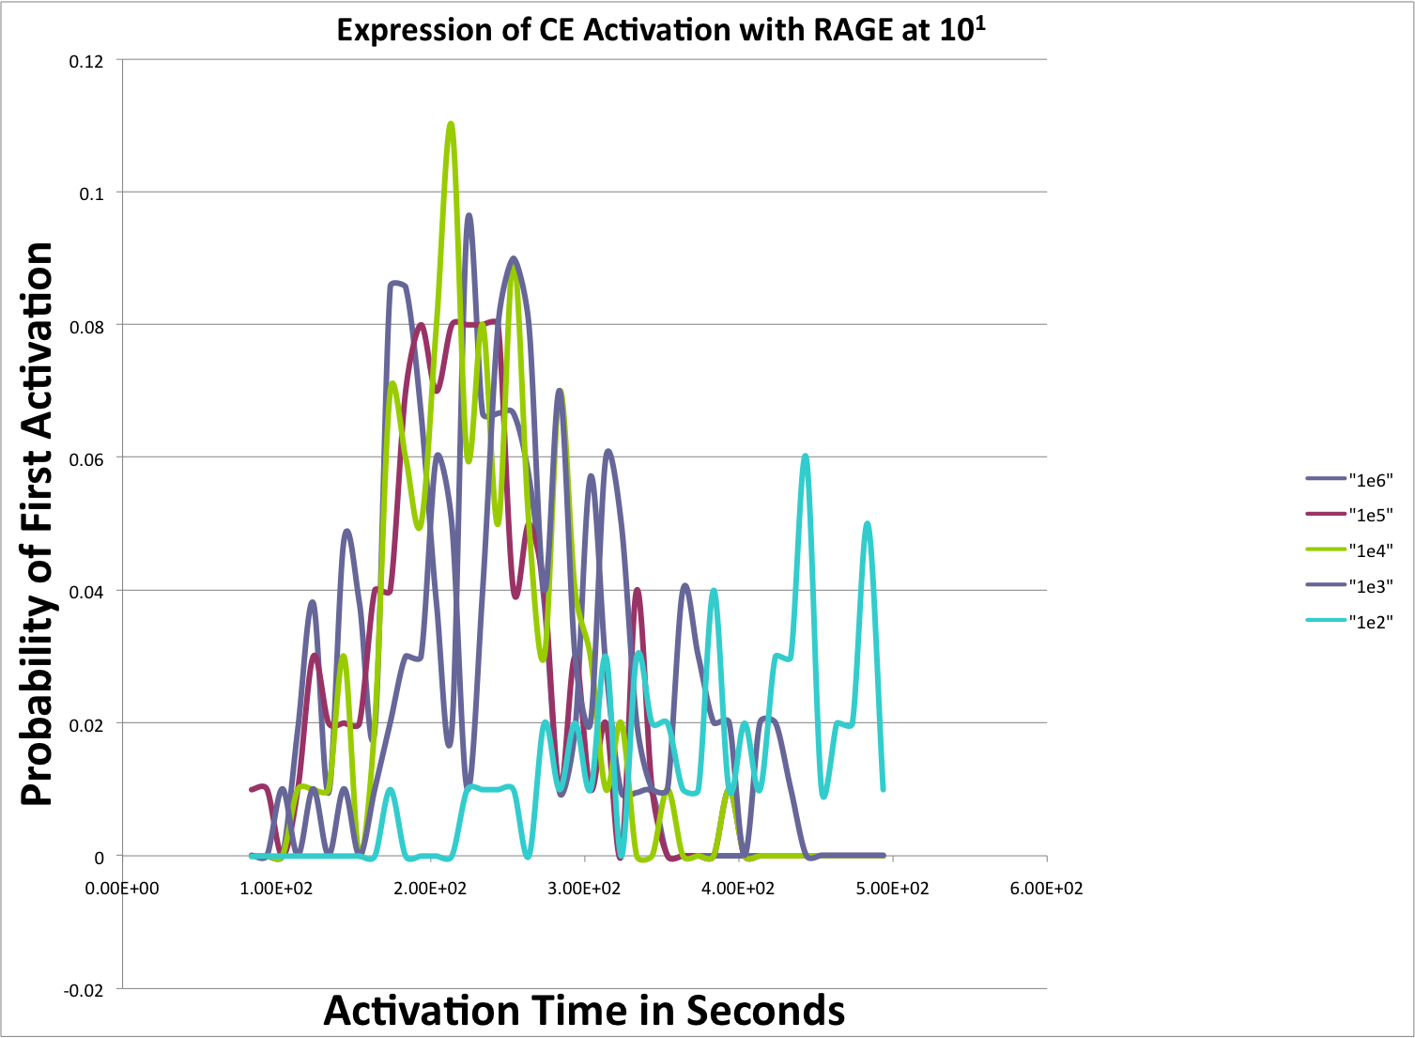
RAGE 10^{1 _} HMGB1 concentrations 1-10⁶

Slide 16
Observations
RAGE at 10¹ –Activation time slows greatly
Probability of activation at a given time decreases

Slide 17
Conclusions
CE activates soonest with “higher” overall concentrations of HMGB1 and RAGE
As RAGE is reduced and our ligand HMGB1 is still at high concentrations first activation of CE is delayed
RAGE expression appears to have the greater impact on CE first activation
Below around 600 RAGE there is no activation of CE even with a very high HMGB1

Slide 18
Issues, concerns, problems
More data would be better
Graphs difficult to analyze
Simulations take too long
Certain parameters and reactions not congruent with biological model – i.e. non-degrading ligand

