Slide 1
The activation time for sos in the egfr pathway
By: Melanie Balmick Hery Ratsimihah
Rachel Spratt

Slide 2
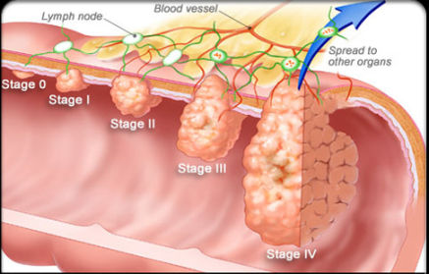
Uncontrolled cell proliferation is a characteristic of cancer
EGF mediated pathways found in pancreatic and lung cancers. Pancreatic cancer is hard to diagnose & cure.

Slide 3
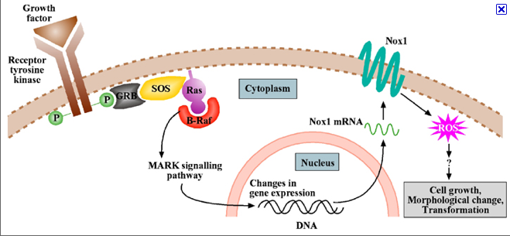
The EGFR Pathway
-EGFR Pathway: a pathway involved in cell proliferation.
-EGF binds to EGFR in the cell membrane, dimers, when phosphorylated, pass protein mediated in the cell.
-Activated Tyrosine kinases have become targets of chemotherapy drugs on the market.

Slide 4
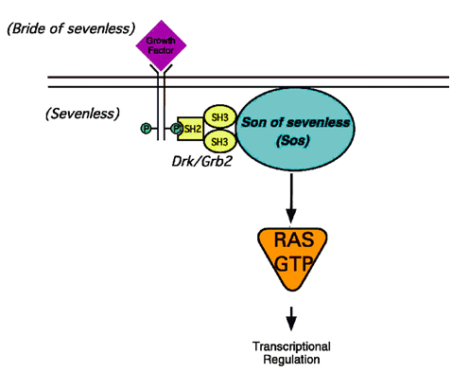
Ratcheting Effect of Protein Mediated Cascade
Activated Sos takes a GDP from the Ras protein which in turn creates transcription factors which can enter the cell nucleus.

Slide 5
Why Sos?

Slide 6
Procedure

Slide 7
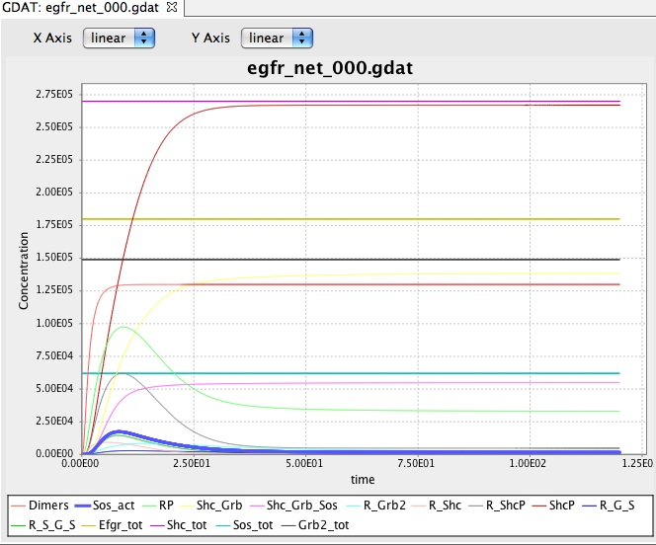
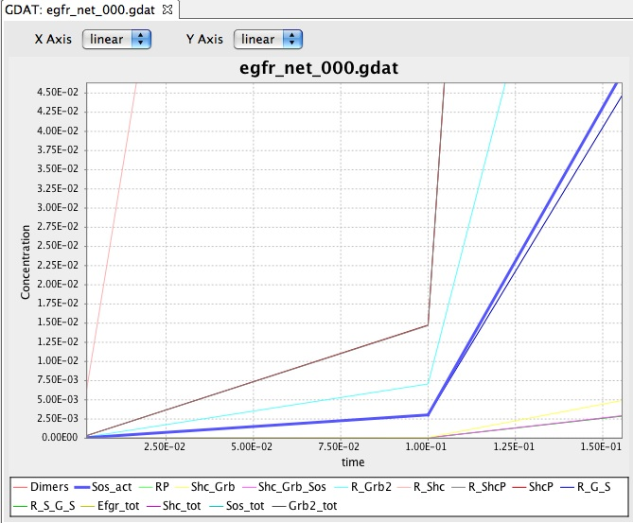
The Template: As It Is
ZOOM
The first peak in Sos represents it’s activation. Graphically, this is how we find the amount of time it takes for Sos to be activated.

Slide 8
Varying the Ligand: EGF
Increase EGF
Faster Activation
Concentration of EGF | Average 1st Activation Time for Sos
1.2e6 | 0.313
2.2e6 | 0.251
3.7e6 | 0.210
4.2e6 | 0.196
1.0e7 | 0.152
*Averages are calculated from running 100 stochastic simulations for each of the above concentration of EGF. The units of time are unspecified.

Slide 9
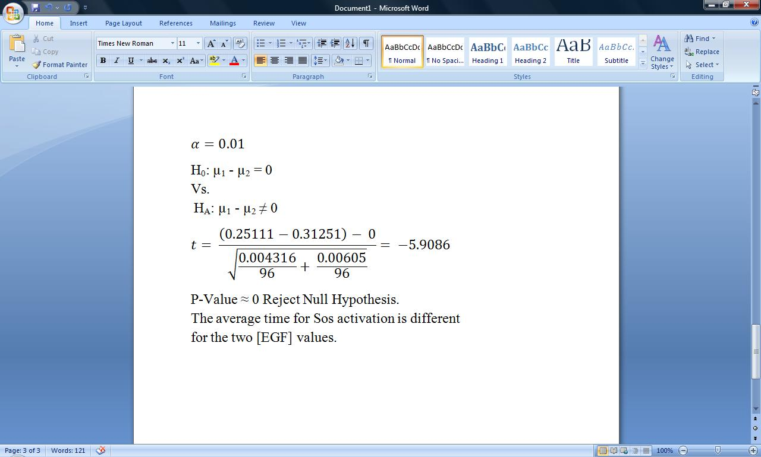
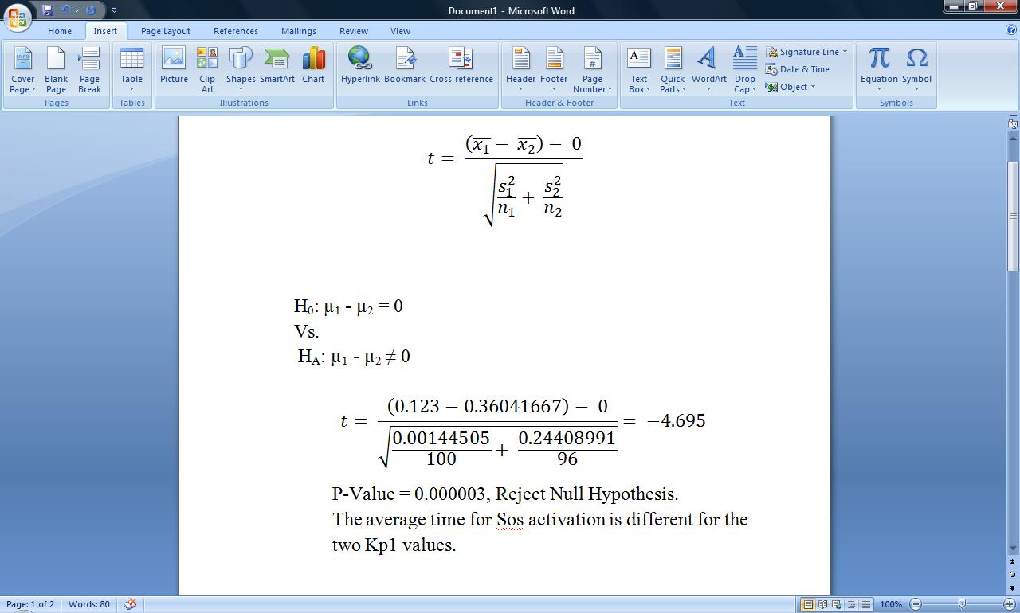
Statistically Significant?
µ1 = 2.2e6 (more EGF) µ2 = 1.2e6 (original amount) Degrees of Freedom: Infinity

Slide 10
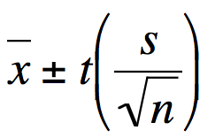
True Population Mean for [ EGF ] 95% Confidence Intervals
For 95% Confidence, t = 1.98
Concentration of EGF | Confidence Interval
1.2e6 | 0.297 < μ < 0.328
2.2e6 | 0.238 < μ < 0.264
3.7e6 | 0.199 < μ < 0.219
4.2e6 | 0.186 < μ < 0.206
1.0e7 | 0.144 < μ < 0.160

Slide 11
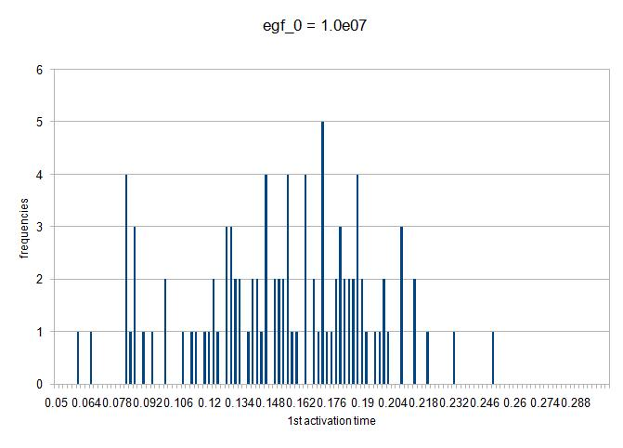
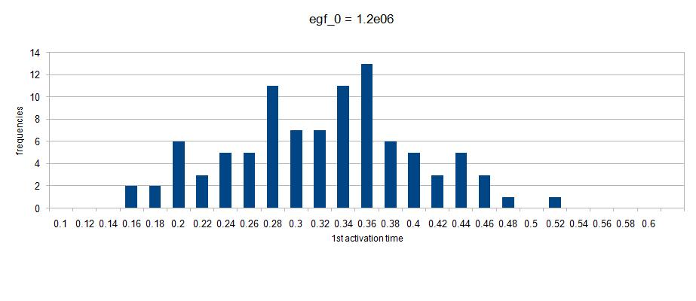
EGF Frequency Histograms
Mean: 0.152 Median: 0.151 Std. Dev.: 0.040
Mean: 0.313 Median: 0.313 Std. Dev.: 0.078

Slide 12
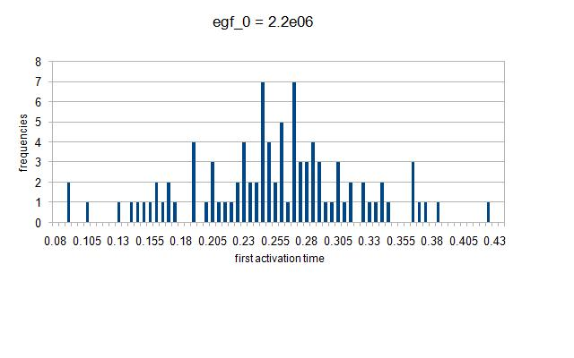
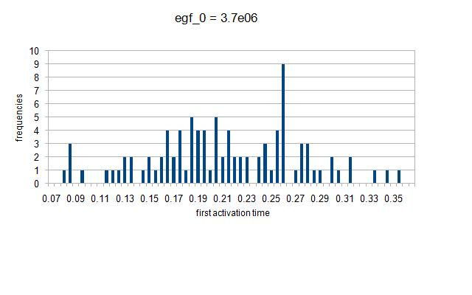
EGF Frequency Histograms, Continued
Mean: 0.251 Median: 0.313 Std. Dev.: 0.250
Mean: 0.210 Median: 0.202 Std. Dev.: 0.060

Slide 13
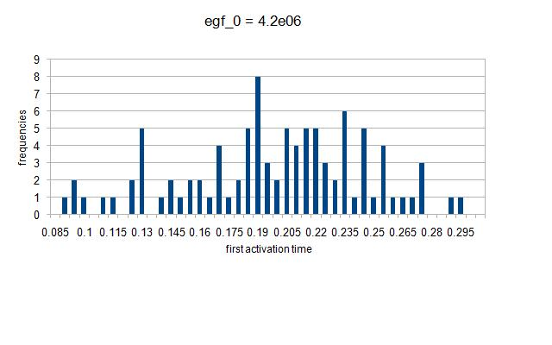
EGF Frequency Histograms, Continued
Mean: 0.196 Median: 0.195 Std. Dev.: 0.047

Slide 14
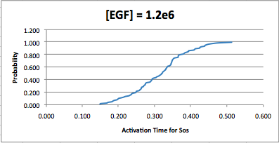
Reading a CDF Probability Distribution
CDFs are interpreted like this: P( Act. Time) ≤ 0.3 ≈ 40%

Slide 15
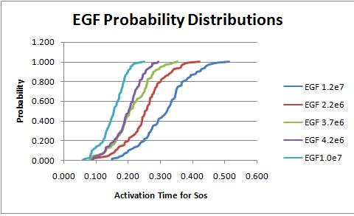
EGF Probability Distribution
The translation of CDF curves, due to the change in concentration, illustrates how concentration effects Sos activation time.

Slide 16
VaryingK-Value for EGF Binding (Kp1)
Decrease Rate
Longer Time
K-Value for EGF – Monomer Binding (Kp1) | Average 1st Activation Time for Sos
4.0e-5 | 0.124
4.0e-6 | 0.234
3.0e-6 | 0.254
1.667e-6 | 0.315
1.667e-7 | 0.692
1.667e-8 | NONE
1.667e-9 | NONE
*Averages are calculated from running 100 stochastic simulations for each of the aboveK-Values.. The units of time are unspecified.

Slide 17
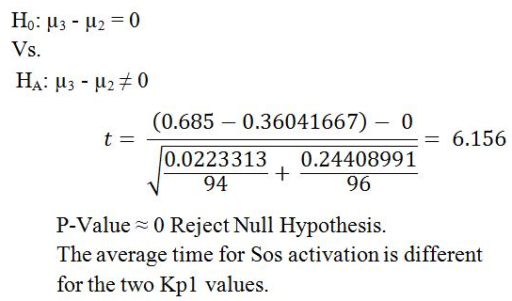
Statistically Significant?
µ1 = 4.0e-5 (faster) µ2 = 1.667e-6 (original) µ3 = 1.667e-7 (slower) df = infinity

Slide 18
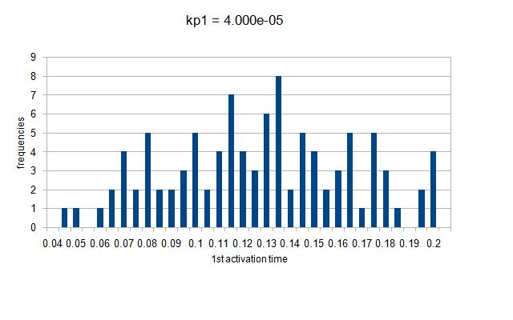
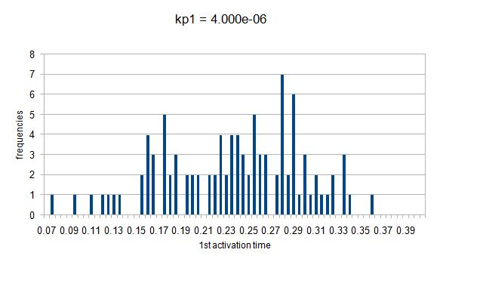
Kp1 Probability Distribution
Mean: 0.125 Median: 0.123 Std. Dev.: 0.038
Mean: 0.234 Median: 0.239 Std. Dev.: 0.060

Slide 19
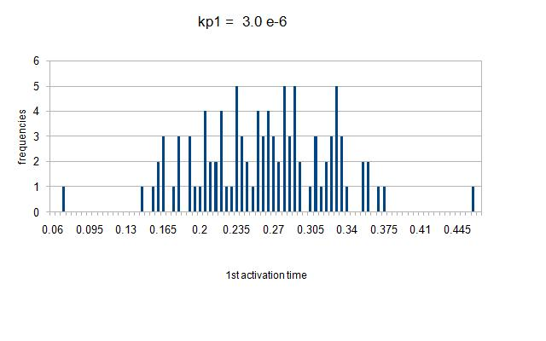
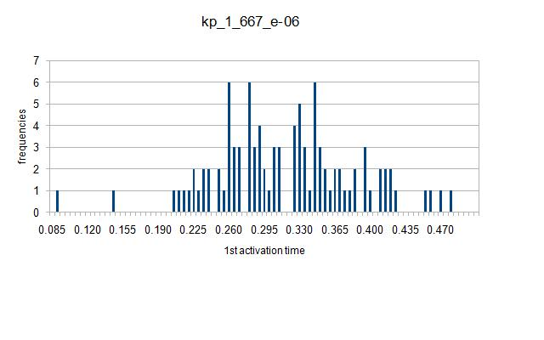
Kp1 Probability Distribution, Continued
Mean: 0.258 Median: 0.256 Std. Dev.: 0.063
Mean: 0.315 Median: 0.300 Std. Dev.: 0.071

Slide 20
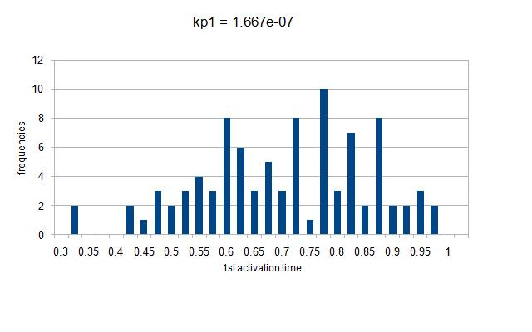
Kp1 Probability Distribution, Continued
Mean: 0.692 Median: 0.681 Std. Dev.: 0.151

Slide 21
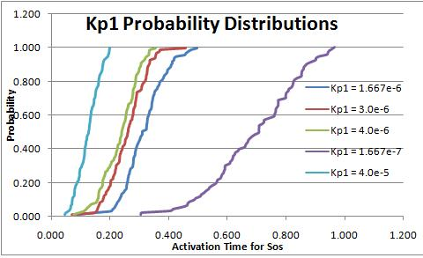
Kp1 Probability Distribution

Slide 22
True Population Mean for Kp1 95% Confidence Intervals
For 95% Confidence, t = 1.98
Kp1 Value | Confidence Interval
4.0e-5 | 0.117 < μ < 0.132
4.0e-6 | 0.222 < μ < 0.246
3.0e-6 | 0.246 < μ < 0.271
1.667e-6 | 0.301 < μ < 0.329
1.667e-7 | 0.661 < μ < 0.723

Slide 23
Issues
EGFR = HUGE Model Generating the model network was time and resource heavy.
Generated files > 5GB for each individual simulation. Ie. Took > 10 minutes/ simulation.
Multiplied by 100 = 500GB of data generated in > 16 hours. Multiplied by 8 (# of tested parameters) = 4TB in 128 hours.

Slide 24
Solution
Both: Use multiple computers
Results: 100 simulations = 5GB -In 1*5mn + 99*1mn = less than 2 hours -On 1 computer: 40Gb in 16 hours -On 8 computers: 5GB/comp in 2 hours total

Slide 25
Conclusions
1- Sos activation is significantly changed when [EGF] and Kp1 are changed. 2- Our expectations were parallel to what our conclusions showed: A. With increasing ligand available, Sos is activated quicker. B. When rate that which EGF binds to the monomer is increased, Sos is activated quicker and vice versa. 3- Attempting this project individually is near impossible. Collaboration between people in different fields is necessary.

Slide 26
Thank you!
MANY THANKS TO THE FOLLOWING PEOPLE:
Nancy Griffeth
Terri Grosso-Applewhite
Aron Wolinetz
Kai Zhao
James Faeder
The National Science Foundation
And all of our fellow colleagues

