Slide 1
INTRINSIC APOPTOSIS PATHWAY
Marieta Garib
Aisha Green
Linda Miranda

Slide 2
WHAT IS INTRINSIC APOPTOSIS AND WHY DO WE CARE?
Programmed cell-death involving permeability of mitchondria.
  Involves Caspase-9
As opposed to extrinsic.
  Tumor necrosis factor
  Caspase-8
  No mitochondria

Slide 3
WHAT IS INTRINSIC APOPTOSIS AND WHY DO WE CARE?
Intrinsic pathway induced by chemotherapeutic agents.
Activation or downregulation of apoptosis influence cancer cell viability.

Slide 4
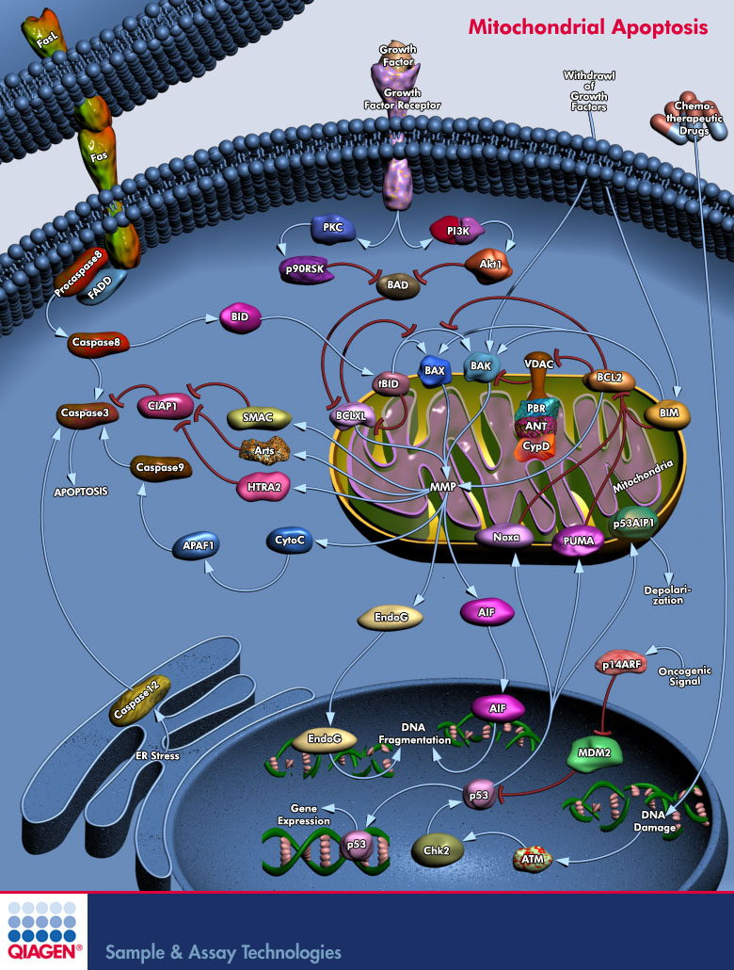
http://www.qiagen.com/GeneGlobe/Pathways/Mitochondrial%20Apoptosis.jpg

Slide 5
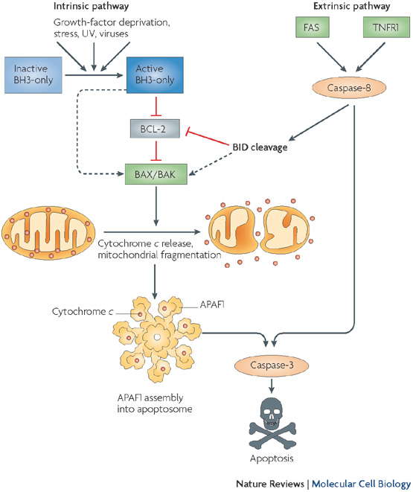

Slide 6
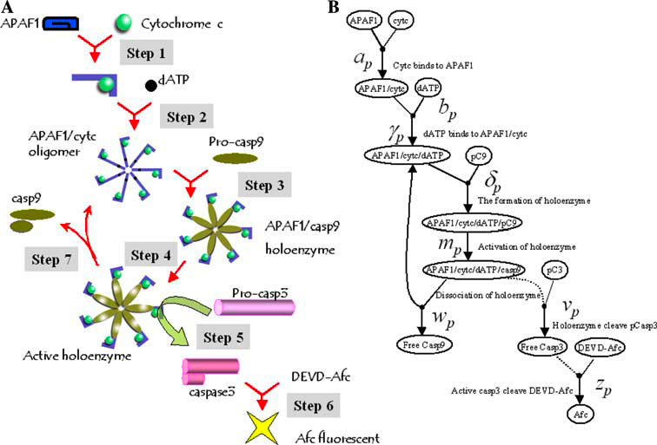

Slide 7
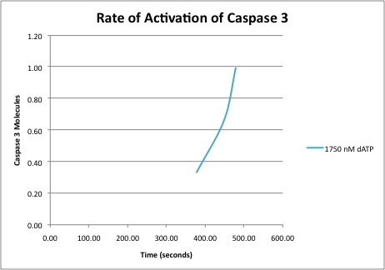
Caspase 3 Activation = 377.940 seconds
1 Molecule = 477.740 seconds

Slide 8
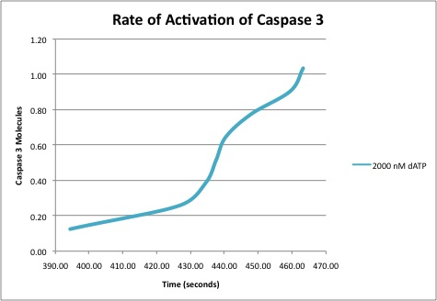
Activation = 394.350 seconds
.99 Caspase-3 = 477.740 seconds

Slide 9
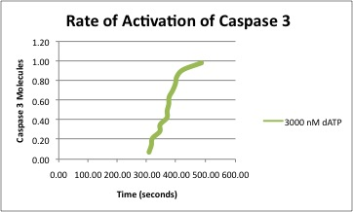
Activation = 306.390 seconds
.98 molecule Caspase-3 = 484.900

Slide 10
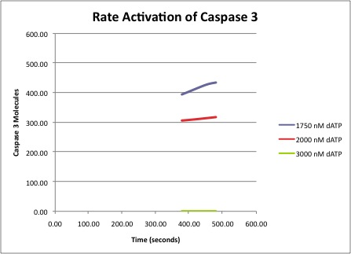

Slide 11
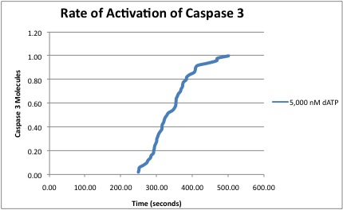
Caspase-3 is activated at 250.250 sec.
1 molecule 499.490 sec.

Slide 12
Activation = 239.044 secs
1 molecule = 490.759 secs

Slide 13
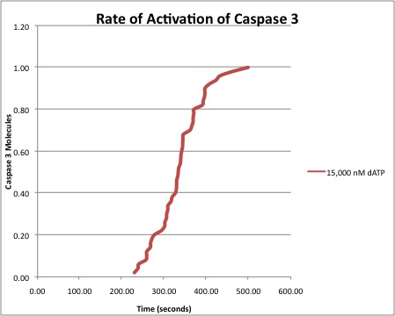
Activation = 229.350 secs
1 molecule = 497.330 secs

Slide 14
Active holoenzyme at 177.137 seconds.
1 molecule of Caspase-3 at 415.351 seconds

Slide 15
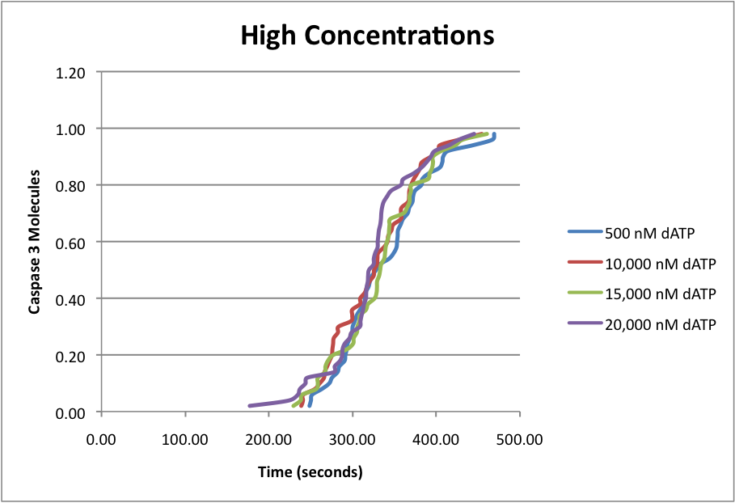

Slide 16
Problems and Issues
choice between intrinsic and extrinsic pathways
finding a target molecule to test
complexity of the chemical reactions and large number of molecules observed

Slide 17
Problems and Issues
difficulty with ODE simulation
long running time of the program due to the complexity of the reactions and the large number of molecules examined
long t_end=>500 to produce results
very long .gdat files

Slide 18
CONCLUSIONS
Varying the concentrations of ATP affects the formation of the holoenzyme
  Higher = faster activation of Caspase-3
  Lower = longer activation time

Slide 19
FUTURE EXPERIMENTS
Vary concentrations of Apaf-1 and Cytochrome C
Will they affect holoenzyme formation?

