Slide 1
Project Procedures
January 17, 2012

Slide 2
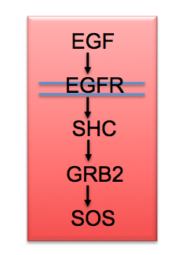
Project Goal
Signal arrives
For efficent simulation:
Cumulative Distribution
Function
F(t) = probability that the activation time is ≤ t
How long?
Activation

Slide 3
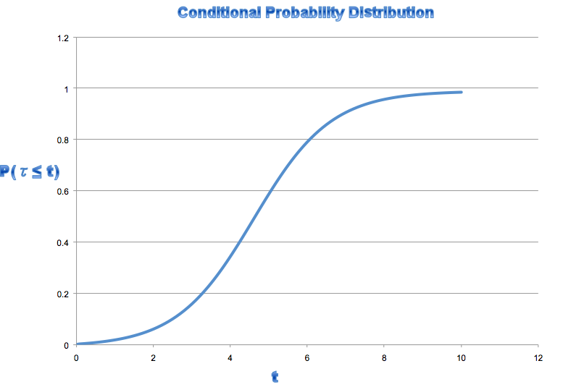
Using a CDF
Pick a number from 0 to <1

Slide 4
Outline of steps
Define the experimental setup
The bngl
Make sure your target species (or collection of species) is an observable
The ligand dosages
The activation criterion (initially, target > 0)
Run the experiment
MultBNGSim_8 script file
Construct the probability distribution
firstpassage.sh
Graph with Excel
Document the experiment and the results
README file under top level directory

Slide 5
Define the experimental setup
The bngl: toy-jim.bngl
Target species must be observable: Rec_DimKp
Identify the ligand: L(r)
Actions at the end of the file: ## actions ## generate_network({overwrite=>1}); # Equilibration simulate_ode({suffix=>"equil",t_end=>100,n_steps=>100,atol=>1e-10,rtol=>1e-8,steady_state=>1,sparse=>1}); saveConcentrations(); # Run the simulation setConcentration("L(r)",20); simulate_ssa({suffix=>"ssa",t_end=>10,n_steps=>1,output_step_interval=>1,atol=>1e-10,rtol=>1e-8,sparse=>1});
The dosages: 10, 20, 30, 40, …
The activation criterion: RecDim_Kp > 0
Notes:
Setting up parameter scan – warnings:
Comment out all actions
Make sure that ligand is initialized to parameter
Play with times and dosages

Slide 6
Running an Experiment
MultBNGSim_8 BNG2file BNGLfile OutputDir
Notes:
From command line
Warning: no relative paths
Your data directory
Your output directory (meaningful name)
Date-time 1
(Value 1)
Date-time 2
(Value 2)
…
.bngl
README
Run0
Run1
Run2
Histogram

Slide 7
Constructing the CDF
firstpassage.sh <DirectoryName>
Argument specifies the directory containing the runs
Output stored in <DirectoryName>/histogram
firstpassage.awk must be modified
Find the column corresponding to the target protein
For “$2” substitute “$<col no>”
Hint: make your target observable the FIRST observable

Slide 8
Documenting
Experiments must be repeatable (although CDF will be slightly different each time!)
Name data files suggestively
Dosages in addition to date/time would be best for bottom-level directories
The bngl should be in the each output directory
README must give experimental design:
The ligand and dosages
The target protein and activation criterion
README should also give
Short description of experiment
Short discussion of result

Slide 9
Some Unix Hints: “Typing” the commands
Use shell variables
HOME is your home directory
“cd $HOME/Desktop” changes your working directory to your Desktop
“set” lists values of shell variables
“export <NAME>=<PATH>” sets the value of the variable NAME to the given PATH
Use $NAME to use the value of NAME in a command
Use copy and paste
When you copy a file from the Mac OS Finder and paste into a command line, it pastes the fully qualified path
Shortcuts
Command completion (TAB key)
Arrows

Slide 10
Experimental setup: Picking the dosages
Use parameter scan
Comment out any actions at the end
Find range where significant activation occurs
Look at timings in gdat files
How to find the files??
Look at different settings for dosages and total time
List intended dosages in README file

Slide 11
Experimental setup: First ssa runs
Do some ssa runs
If concentrations were very low from ode runs, anticipate that times will need to be much larger!

