Slide 1
CUNY’s Pathways to Degree Completion Initiative
Dene Hurley and Esther Wilder
Pathways Working Committee
Prepared for the Lehman College Senate Meeting
October 12th, 2011

Slide 2
Pathways Initiative
June 27th 2011: CUNY Board of Trustees passed the resolution to create “Pathways to Degree Completion Initiative”, “designed to create a curricular structure that will streamline transfers and enhance general education across the university.”
Three central elements:
Gen Ed Framework: Made up of 2 components – (i) a “Common Core” (30 credits) which is common to all CUNY schools, and (ii) “College Option” (12 credits) which is specific to each CUNY senior college.
Pathways to Largest Transfer Majors : To establish clear pathways for the largest transfer majors (identified as Accounting, Criminal Justice, Psychology, Business, Finance, Education, Biology, English Language and Literature, and Nursing), 3 to 6 courses in major or related fields will be identified and accepted as pre-requisites in all colleges that offer these majors.
Full Course Transferability: “All courses taken for credit at an undergraduate CUNY college to be accepted for credit at every other CUNY college (though not necessarily as Gen Ed or major credit) regardless of whether a specific equivalency exists at the transfer college”

Slide 3
Charge of Pathways Task Force
The charge of the Task Force is to create a 30 credit “Common Core” “by establishing learning outcomes in multidisciplinary areas.”
The Task Force is made up of:
(1) The Steering Committee which will “initiate and direct the process”, and;
(2) The Working Committee whose functions are to “advise on learning outcomes” and for “communicating information to and from the campuses.”

Slide 4
The Steering Committee
Chair: Dean Michelle Anderson, CUNY School of Law
Members:
Paul Attewell, Distinguished Professor of Sociology, Graduate Center
Michael Barnhart, Professor of Philosophy, Kingsborough Community College
Laird Bergad, Distinguished Professor of Latin American and Caribbean History, Lehman College, and Executive Director of the Center for Latin American, Caribbean and Latino Studies, Graduate Center
Theodore Brown, Professor of Computer Science, Queens College, and Executive Officer, Doctoral Program in Computer Science, Graduate Center
Katherine Conway, Associate Professor and Deputy Chairperson of Business Management, Borough of Manhattan Community College
Edward Grossman, Professor of Mathematics, City College of New York
Mona Hadler, Professor of Art, Brooklyn College
Orlando Hernandez, Professor of Modern Languages, Hostos Community College
Patricia Mathews-Salazar, Professor of Anthropology and Director of the Center for Ethnic Studies, Borough of Manhattan Community College
Elizabeth Nunez, Distinguished Professor of English, Hunter College
Neal Phillip, Professor of Chemistry and Chair of the Department of Chemistry and Chemistry Technology, Bronx Community College
William Fritz, Provost, College of Staten Island
Anne Lopes, Dean of Undergraduate Studies, John Jay College
Elizabeth Beck, student, LaGuardia Community College
Steven Rodriguez, student, City College of New York

Slide 5
Pathways Working Committee
Chair: Dean Michelle Anderson, CUNY School of Law
Members:
Emily B. Anderson, Professor and Chairperson, Department of Social Sciences and Human Services, Borough of Manhattan Community College
Martin Braun, Professor of Mathematics and Director of Freshman Year Initiative, Queens College
Charlotte Brooks, Assistant Professor of History, Baruch College
Donal Byard, Associate Professor of Accounting, Baruch College
Peter Catapano, Associate Professor of History, New York City College of Technology
Alex Couzis, Professor and Chairman, Department of Chemical Engineering, The City College of New York
Ashley Dawson, Associate Professor and Chairperson, Department of English, College of Staten Island
William Divale, Professor of Anthropology, York College
Emmanuel Egbe, Professor of Business, Medgar Evers College
Eva Fernandez, Associate Professor of Linguistics & Communication Disorders, Queens College
James Freeman, Professor and Chairperson, Department of Social Sciences, Bronx Community College
Andrea Gabor, Professor of Journalism, Baruch College
Maria (Maki) Haberfeld, Professor and Chair, Department of Law, Police Science and Criminal Justice Administration, John Jay College of Criminal Justice
Dene Hurley, Assistant Professor of Economics and Business, Lehman College
Yehuda Klein, Associate Professor of Economics, Brooklyn College
David Lieberman, Professor and Chairperson, Department of Physics, Queensborough Community College
Keming Liu, Professor of English, Medgar Evers College
Alan Lyons, Professor of Chemistry, College of Staten Island
Robert Melara, Professor and Chairperson, Department of Psychology, The City College of New York

Slide 6
Pathways Working Committee (cont’d)
Luis Montenegro, Professor and Chairperson, Department of Physics and Technology, Bronx Community College
Gloria Nicosia, Professor and Chairperson, Department of Communications and Performing Arts, Kingsborough Community College
Lisandro Perez, Professor and Chairperson, Department of Latin American and Latina/o Studies, John Jay College of Criminal Justice
Rolando Perez, Associate Professor of Spanish, Hunter College
Jonathan Peters, Professor of Finance, College of Staten Island
Shirley Raps, Professor and Chairperson, Department of Biological Sciences, Hunter College
Margaret Reilly, Professor of Nursing, Queensborough Community College
Howard Ruttenberg, Professor of Philosophy, Department of History and Philosophy, York College
Kim Sanabria, Professor, Department of Languages and Cognition, Hostos Community College
Patricia Schneider, Professor of Biological Sciences and Geology, Queensborough Community College
David Smith, Professor and Chairperson, Department of Entertainment Technology, New York City College of Technology
Jeffrey Suzuki, Associate Professor of Mathematics, Brooklyn College
Debra Swoboda, Associate Professor of Psychology, York College
Valerie Taylor-Haslip, Associate Professor of Health Sciences, LaGuardia Community College
Lynn M. Thomson, Professor of Theatre, Brooklyn College
Scott White, Associate Professor, Library, LaGuardia Community College
Esther Wilder, Associate Professor of Sociology, Lehman College
José Luis Morín, Vice President of Academic Affairs and Provost, The New Community College
Jennifer Fernandez, Student Government President, Kingsborough Community College
Liliete Lopez, CUNY Coalition of Students with Disabilities, Queens College

Slide 7
Timeline for Summer/Fall 2011
June 27, 2011: CUNY Board of Trustees passed resolution on efficient transfer system
July 27, 2011: First Steering Committee Meeting
August 2011: Second Steering Committee Meeting (8/19) and first Task Force Meeting (8/26)
September 2011: Third Steering Committee Meeting (9/9) and Fourth Steering Committee Meeting (9/23)
October 2011: Fifth Steering Committee Meeting (10/7), Second Task Force Meeting (10/14), and Disciplinary Committees for Largest Transfer Majors convene
November 1, 2011: Draft Report and Recommendations for the 30 Credit Common Core to be distributed to the University Community online and invited for comments
November 15, 2011: Comment period closes
December 1, 2011: Steering Committee submits revised report and recommendations to Chancellor Goldstein

Slide 8
Strategies for Gen Ed Framework
At its meeting in mid-August, the Steering Committee considered and discussed the strengths and weaknesses of two primary strategies for restructuring the General Education framework, which are:
(1) Cross-curricular Learning Outcomes Approach: Develop cross-curricular learning goals first, then identify Common Core areas and credit allocation, then map cross-curricular learning outcomes onto multidisciplinary areas
(This approach expands on the Liberal Education and America’s Promise (LEAP) model developed by AAC&U)
(2) Specific Areas Learning Outcomes Approach: Identify Common Core areas and credit allocations first, then devise learning outcomes for each area
By a vote of 9-5, the Steering Committee approved Approach #1.
Why Approach #1? : “Focuses on student learning rather than course matching”

Slide 9
August Task Force Retreat
At the August 26th Task Force retreat, the Task Force (both Steering Committee and Working Committee) broke into groups to focus on discussing and developing cross-curricular learning objectives.
Seven groups: most, but not all, drew on the AAC&U/LEAP’s “Essential Learning Outcomes.”

Slide 10
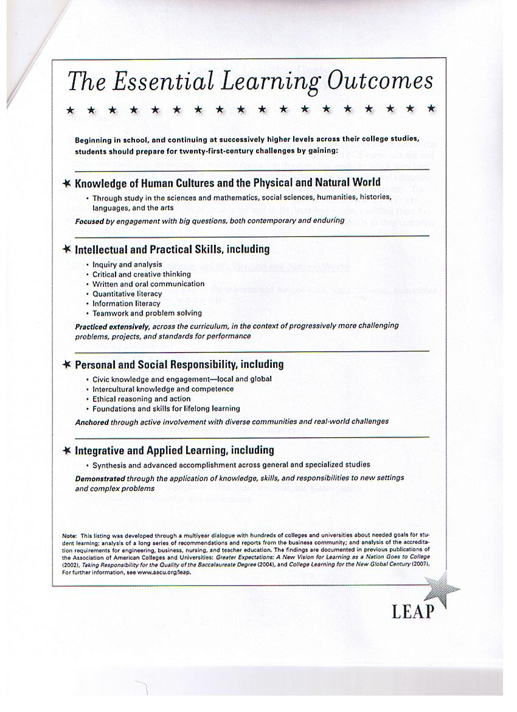

Slide 11
September Steering Committee Meetings: Learning Goals Identified
Primary objective of September 9th meeting was to create cross-curricular learning goals
The “Essential Learning Goals” were revised and accepted at September 23rd meeting

Slide 12
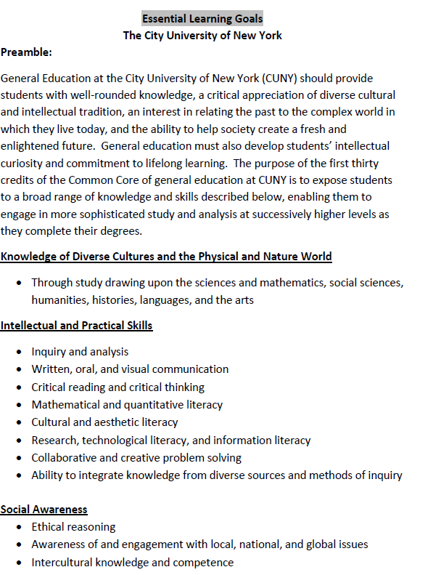

Slide 13
Identifying Common Core Areas
With cross-curricular learning goals broadly defined, the next task for the Steering Committee involved identifying common core areas.
Dean Anderson has stated that the steering committee hopes that the broad learning goals that have been identified “can help the Task Force shape the development of specific learning outcomes for the multidisciplinary areas of the Common Core once the Task Force has identified them.”

Slide 14
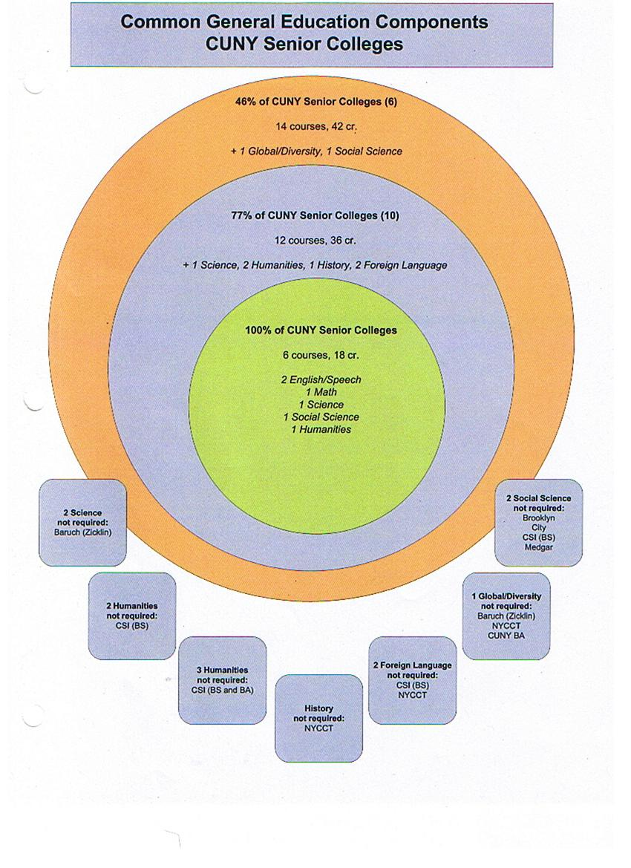

Slide 15
Oct 7th Steering Committee Meeting: Proposed “Common Core” Structure
Required Courses: (15 credits)
English Composition: 7 credits
Mathematical and Quantitative Reasoning: 4 credits
Natural and Physical Sciences: 4 credits
Flexible Common Core Credits (15 credits): five, 3-credit, liberal arts courses for 15 credits in the following four areas, with at least one course from each area and no more than one course in any particular discipline:
1. World Cultures — courses drawn from foreign languages, anthropology, history, political science, economics, world literature, and other fields addressing global cultures.
2. U.S. Experience in its Diversity — courses drawn from history, political science, economics, sociology, U.S. literature, and other fields addressing the U.S. experience in its diversity.
3. Creative Expression — courses drawn from the fine arts, creative writing, communication, music, theater, and other fields addressing creative expression.
4. Individual and Society — courses drawn from anthropology, philosophy, psychology, religion, computer science and other fields addressing the relationship between the individual and society.

Slide 16
Pathways Task Force: Agenda for Oct 14th Retreat
To discuss the structure of the Common Core and learning outcomes for the Common Core areas ( to be drafted by the Steering Committee )

Slide 17
The Disciplinary Committees
By now all CUNY faculty should have received an email from Chancellor Goldstein which states:
“The next phase of this work is to establish, CUNY-wide, the first three to six courses that lead into the largest transfer majors. The resolution specifies that recommendations for these courses are to be made by May 1, 2012, to the Office of Academic Affairs by relevant disciplinary committees. The first majors to be the subject of this work are: Accounting and Related Services; Biology; General Business Administration, Management and Operations; Criminal Justice and Corrections; English Language and Literature; General Finance and Financial Management Services; Nursing; Psychology; General Teacher Education and Professional Development.”

