Slide 1
Laboratory Safety
Lehman College
Environmental Health & Safety
November 2011

Slide 2
Introduction
Regulatory agencies and laboratory safety

Slide 3
Federal, State, and NYC regulatory agencies
Occupational Safety & Health Administration
New York State Department of Labor Public Employees Safety & Health
New York City Fire Department
(NYS DOH, NYC DOHMH – Radiation Safety)
City University of New York

Slide 4
OSHA Lab Standard: Chemical Hygiene Plan
OSHA Lab Standard adopted by NYS PESH
Written plan for protecting employees from chemical exposure
Elements of the Chemical Hygiene Plan:
Employee exposure monitoring
Training
Medical consultation
Hazard identification
Respirator use
Fume hoods
Recordkeeping
Notes:
Employee exposure monitoring: employee exposure monitoring is required under the OSHA lab standard when there is reason to believe the employee’s exposure may exceed the OSHA Permissible Exposure Limit (PEL) or the action level (1/2 the PEL) for that chemical. Although lab work generally uses relatively small amounts of hazardous chemicals, and much of the work occurs inside fume hoods, there are some procedures that may increase the risk of exposure. If a lab worker has reason to believe exposure is taking place, please contact EH&S to evaluate whether monitoring is warranted. The employee will be notified of the results with 15 days of receiving the monitoring results.
Training: lab workers must be trained on the chemical hazards in their labs. Training is given at the time of initial employment, and annual refresher training. Training includes: methods of detection of hazardous chemicals), hazardous properties of chemicals, exposure limits, signs and symptoms of exposure, employee protection measures, specialized training when new hazards are introduced in the lab, resources for chemical hazard information, emergency procedures.
Medical consultation will be provided to the employee at no cost if the employee shows signs and symptoms of exposure, or if there is reason to believe that exposure has occurred (large uncontained spill, fire, explosion, etc.). Consultations (and, if necessary, medical examinations) shall be performed by a licensed MD; the findings shall be shared with the employer, but will contain info related to chemical exposure only.
Hazard Identification: chemical labels must be intact and accurate to the container’s contents; MSDS must be made available to employees.
Respirator use: IF it necessary for an employee to use a respirator to control chemical exposures, then a respirator will be provided by the employer at no cost to the employee. In addition, all the elements of the OSHA respiratory standard will be complied with by the employer.
Fume hoods: will be evaluated on at least an annual basis, and will be kept in good working order by the employer.
Recordkeeping: health effects of chemical exposure may take decades to devleop; employee exposure monitoring records and medical consultation records with be kept by the employer for 30 years beyond the end of the person’s employment.

Slide 5
FDNY: Fire Protection for Laboratories Using Chemicals
Updated (2008) regulations for fire prevention in non-production chemical laboratories
Covers all academic labs: elementary, high school, college, hospital, research, etc.
C14 Certificate of Fitness based on these new regulations

Slide 6
Annual FDNY Inspections
Labs are inspected by FDNY starting in January
Labs must be in compliance with FDNY regulations
FDNY inspector may also cite other types of violations not specifically covered by regulations
Violation orders must be corrected before new permit can be issued

Slide 7
Resource Conservation and Recovery Act (RCRA)
Federal EPA regulations for hazardous waste
All hazardous waste is disposed through Environmental Health and Safety
No drain disposal of hazardous materials EVER!

Slide 8
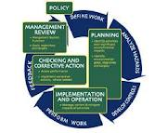
CUNY Environmental Management System (EMS)
Environmental requirements
Composite of federal, state, NYC, other environmental regs
Aspects of the EMS relevant to labs will be covered in the next unit, Hazardous Waste
Also covers petroleum, air emissions, pesticides
Reporting requirements, training, inspections procedures

Slide 9
Laboratory Inspections
Lehman EH&S
CUNY EH&S
NYC Dept of Environmental Protection
Environmental Protection Agency
More about inspections later
Notes:
EH&S personnel conduct formal annual inspections in labs, and informal inspections at other times, usually when visiting a lab for another reason.
As part of its agreement with EPA, CUNY EHSRM conducts scheduled and unscheduled environmental audits of all CUNY campuses with the understanding that the campuses will correct any issues discovered during CUNY’s audits immediately. Findings of CUNY’s recent audit of Lehman on the next slide.
DEP will come to campus to follow up on our annual Right-to-Know reporting, in which Lehman reports our chemical inventory to NYC DEP and FDNY, primarily inspecting chemical storage rooms, and B&G’s storage areas.
Federal EPA will inspect all areas known to contain potential environmental hazards, but will also be allowed access to areas not known to contain these hazards, which may result in inspectors findings hazards previously-unknown to Lehman College personnel, a very bad outcome…

Slide 10
Hazard recognition
What are the chemical and physical hazards in the lab?

Slide 11
Hazards in the laboratory
Chemical hazards:
Flammable
Corrosive
Reactive
Toxic
Can be a combination of one or more hazard classes
Physical hazards:
Electrical
Cryogenic
(lasers)
(radioactive)

Slide 12
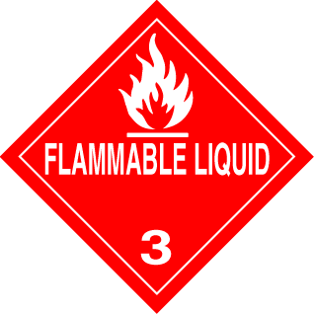
Flammable Liquids
Flashpoint < 100F (FDNY)
Flashpoint: “the lowest temp at which a liquid emits enough vapor to form an ignitable mixture in air”
Incompatibilities: oxidizers, acids
Flammable storage limits: 15 gallons per lab (FDNY)
Ex. – most nonhalogenated organic solvents (alcohols, benzene, alkanes, alkenes, alkynes; ethers; dichloroethane; etc. etc. etc.)

Slide 13
Need to refrigerate your flammables?
Flammable materials (liquids) must be stored in flammable- or explosion-proof refrigerators only
“No flammables flashing <100F” signs are posted on “Regular” lab refrigerators (FDNY)
Cool flammable liquids in dry ice/acetone or ice bath instead

Slide 14
Flammable Solids
Causes fire upon exposure to air, water, or spontaneous chemical reaction
white phosphorus
Alkali metals
Finely-divided metals
Nitrocellulose
Dinitro-, trinitro compounds
Organic peroxides
FDNY storage limit: 2 lbs

Slide 15
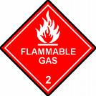
Flammable gases
Form explosive mixtures
in air:
Hydrogen
Carbon monoxide
Part of ongoing processes only
Connected to equipment requiring flam gas use
one cylinder in use, plus one cylinder in reserve
Store separate from oxidizing gases

Slide 16
Corrosive materials
Liquids
(Solids)
Gases
Physical form must also be considered when evaluating the degree of hazard

Slide 17
Corrosive liquids
Most commonly encountered in the lab
Acids: hydrochloric, sulfuric, nitric, perchloric, (hydrofluoric)
Bases: NaOH, KOH; base bath
Organic solvents
Even non-fuming types tend to fume
Always work in a fume hood
Wear gloves, goggles, labcoat

Slide 18
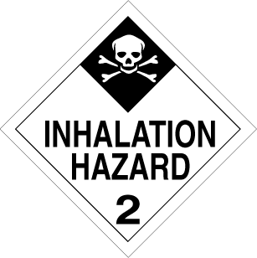
Corrosive gases
More seriously hazardous than liquids or solids
Respiratory tract as well as surface tissues vulnerable
Region of respiratory tract affected is directly related to degree of water solubility
High solubility: HCl, HF - upper respiratory tract
Medium solubility: Cl, oxides of N - bronchi
Low solubility: phosgene - alveoli

Slide 19
Toxic materials
Everything is toxic; the dose makes the poison
Local or systemic effect
Route of entry
Target organ
Types of toxic effects
Irritant
Sensitizer/allergen
Carcinogen
Mutagen

Slide 20
Purchasing Chemicals
Please limit the amounts of chemicals to your immediate needs
Do not stockpile chemicals
old chemicals = inherently waste-like , when stored with newer chemicals of the same type
Test peroxidizable chemicals every 6 months

Slide 21
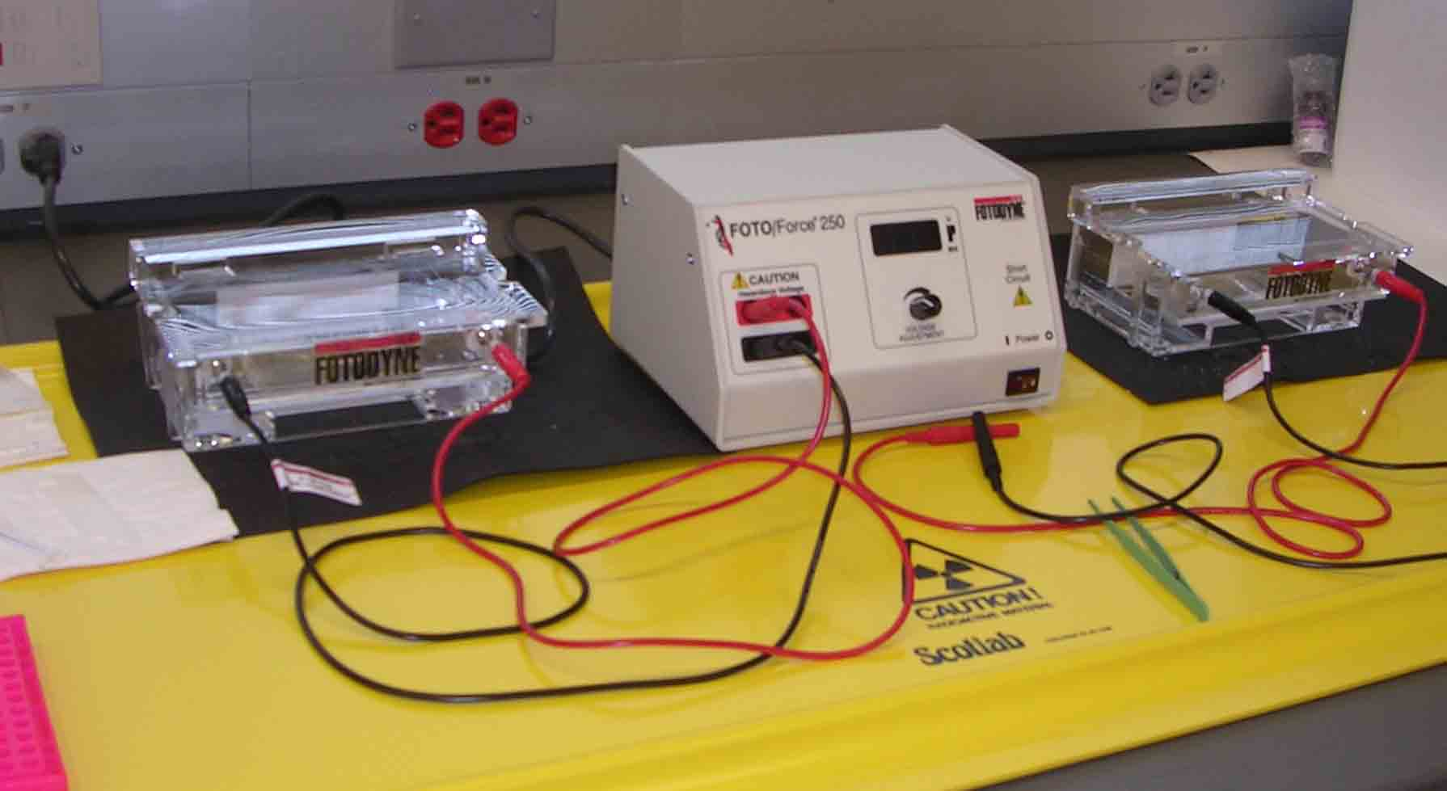
Physical Hazards: Electrical Hazards
Inspect electrical equipment for frayed cords, exposed wires
Intact or damaged equipment = spark source
Repair/replace worn electrical equipment!
Post High Voltage signs at electrophoresis setups and power supplies
When working with flammables, use intrinsically safe electrical equipment only

Slide 22
Hazard Control
Administrative controls
Engineering controls
Personal Protective Equipment

Slide 23
Hazard Protection
Administrative controls
Employee information and training
Material Safety Data Sheets (MSDS)
lab inspections by EH&S, others
Engineering controls
Chemical fume hoods
Personal Protective Equipment - PPE
Eye protection
Protective clothing (labcoats, gloves)
Respiratory protection

Slide 24
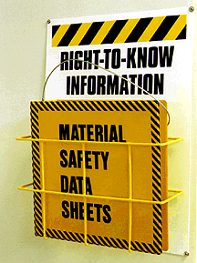
Material Safety Data Sheets (MSDS)
Chemical hazard information supplied by the manufacturer (OSHA)
MSDS accompanies each chemical shipment
Required for both pure chemicals and chemical products (mixtures) containing hazardous chemicals
All hazardous components >1%
Exact percent composition not required
Read MSDSs from many different
sources for a single chemical for a
more complete understanding of hazard

Slide 25
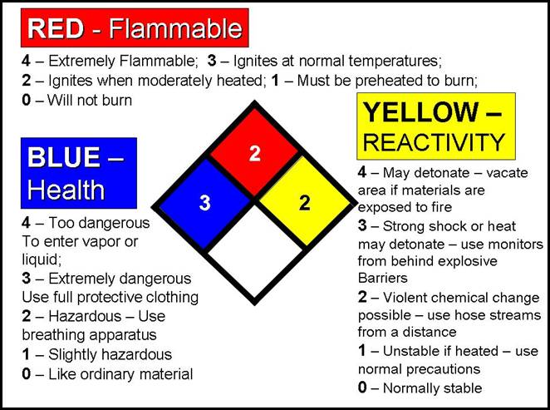
Hazard Information: Chemical Labels: National Fire Prevention Association (NFPA) hazard rating system

Slide 26
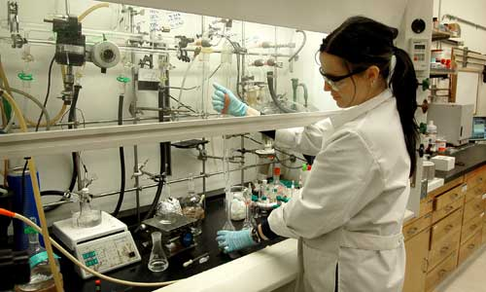
Chemical Fume Hoods
Engineering controls (fume hoods) are the first line of defense against hazardous chemical exposure
Hazard is removed from worker environment
Laboratory air is not recirculated; air is exhausted directly to the outdoors through the fume hoods
Proper fume hood use minimizes/eliminates chemical exposures

Slide 27
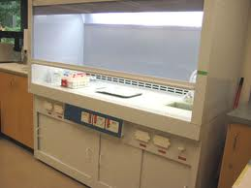
A Biosafety cabinet is not a chemical fume hood
Not for worker protection
Most laminar flow hoods protect the product from contamination only
Draws in HEPA-filtered air from lab to make a “curtain” of air through the front opening
blows HEPA-filtered air out through top
Not for use with hazardous materials (chemical vapors pass through HEPA filter)

Slide 28
Fume hood guidelines
Turn fume hood ON
Check for airflow by holding a kimwipe or tissue at the hood face
Work at least 6” inside hood to ensure capture of chemical vapors
Lower the sash to 12-18” for proper face velocity, to protect the breathing zone, and provide splash protection

Slide 29
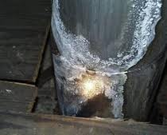
Perchloric acid fume hood
Used for procedures in which perchloric acid is boiled to near-dryness
Perchlorate salts settle on hood surfaces, ducts
Reacts violently with organic materials
Washdown feature rinses interior surfaces
Single ducted (not combined with other fume hoods)
Perchlorates crystalizing on fume hood duct

Slide 30
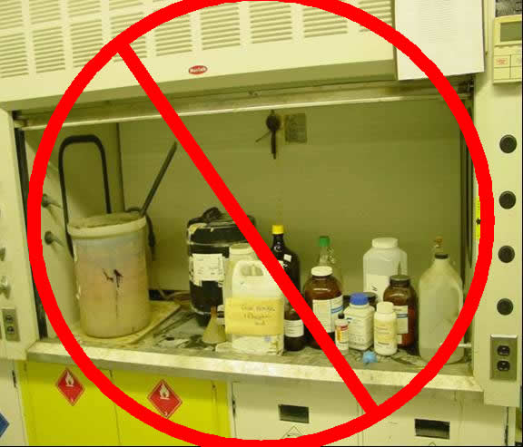
Fume hood guidelines
100 feet/minute air velocity is easily disrupted
Fume hoods should be located away from doors, walkways
Clutter in fume hoods affects airflow
Raise large equipment on jacks to allow proper airflow
Close fume hood sash when not in use
Fume hoods are intended for worker protection, not chemical storage

Slide 31
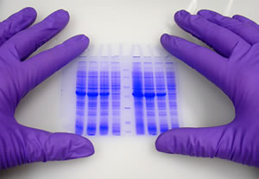
Personal protective equipment
PPE is the last line of defense against chemical exposure
Required PPE for all persons working in labs:
Eye protection
Gloves
labcoat
Check MSDS for proper glove selection
Latex exam gloves rapidly degraded by many chemicals
Nitrile gloves provide greater protection

Slide 32
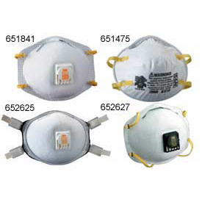
Respiratory protection
Not recommended!
Re-examine procedures and work practices before resorting to respiratory protection
Do not obtain a respirator on your own
Contact EHS for evaluation
If respirator use is warranted, Lehman will provide equipment, training, medical consultation, etc. etc. etc.

Slide 33
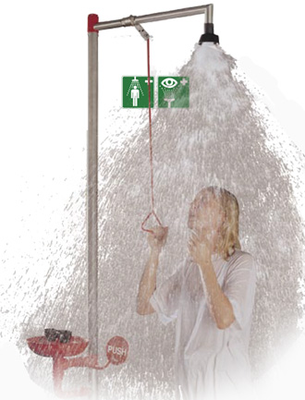
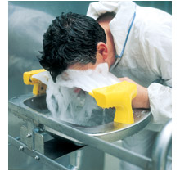
Emergency Procedures
Chemical splash on body: minimize duration of contact = minimize injury
Use only water to remove chemicals
Know the location(s) of the emergency eyewash and shower BEFORE anything happens
Do not hesitate to use!
FLOOD affected area for 15 minutes, then contact Public Safety or EHS

Slide 34
Contact Information
Public Safety
Environmental Health & Safety office
X7777
APEX 109
All hours
After hours, Public Safety will contact EHS personnel
X8988
Music Building, room B37A
Working hours, 9am – 5 pm
After hours, EHS personnel will be contacted by Public Safety

Slide 35
Chemical release in a lab
Small spills are cleaned up by lab personnel
Larger spills, or uncontained spills of more hazardous materials are handled by CUNY’s HazWaste contractor
Contact Public Safety x7777, or EHS x8988
Describe nature of the spill (chemical name, amount, exact location of spill)
Depending on the nature of the spill, you may be asked to evacuate the lab/floor/building

Slide 36
Laboratory Inspections
Who conducts inspections?
What do lab personnel need to do?

Slide 37
Laboratory Inspections
Lehman EH&S: all areas
CUNY EH&S: all areas in which potential environmental hazards exist
NYC Dept of Environmental Protection: chemical storage rooms
Environmental Protection Agency: all areas in which potential environmental hazards exist
Notes:
EH&S personnel conduct formal annual inspections in labs, and informal inspections at other times, usually when visiting a lab for another reason.
As part of its agreement with EPA, CUNY EHSRM conducts scheduled and unscheduled environmental audits of all CUNY campuses with the understanding that the campuses will correct any issues discovered during CUNY’s audits immediately. Findings of CUNY’s recent audit of Lehman on the next slide.
DEP will come to campus to follow up on our annual Right-to-Know reporting, in which Lehman reports our chemical inventory to NYC DEP and FDNY, primarily inspecting chemical storage rooms, and B&G’s storage areas.
Federal EPA will inspect all areas known to contain potential environmental hazards, but will also be allowed access to areas not known to contain these hazards, which may result in inspectors findings hazards previously-unknown to Lehman College personnel, a very bad outcome…

Slide 38
Common FDNY violations
Flammable storage over FDNY limit (15 gallons for most labs)
Inadequate Certificate of Fitness coverage
Peroxide-forming chemicals not labeled with their opening dates
Incompatible chemicals stored together
Housekeeping issues…

Slide 39
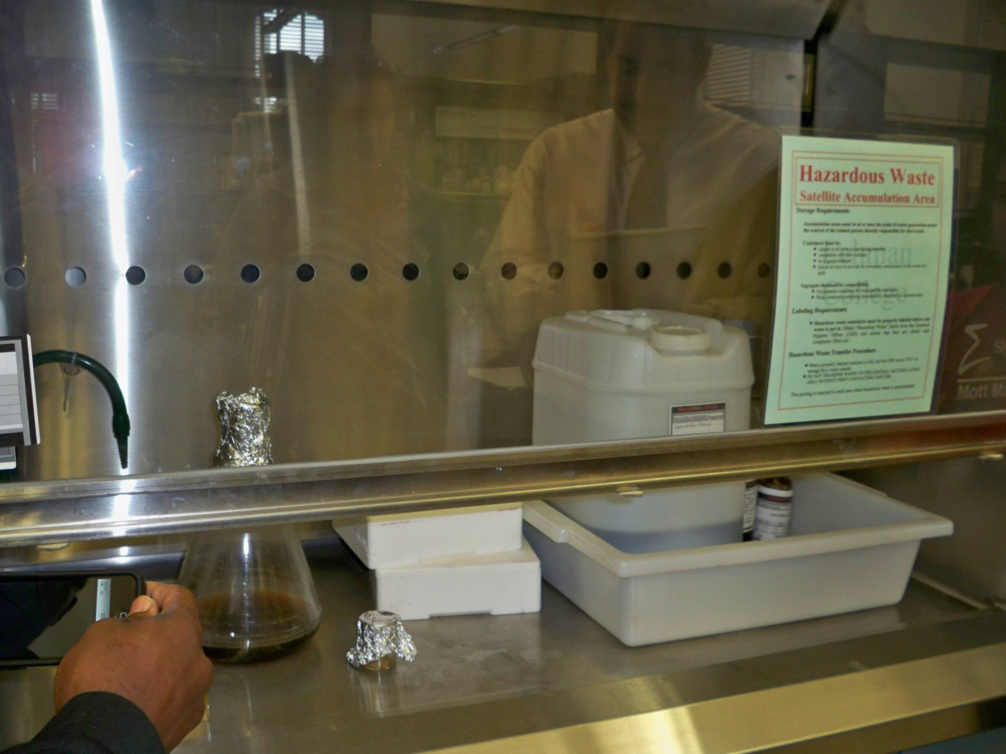
What were some of the findings of the CUNY environmental audit?
What’s wrong with this picture?
Unlabeled (waste?) containers
Al-foil used as container caps
5-Gallon waste container is too large for HazWaste collection (would take years to fill)

Slide 40
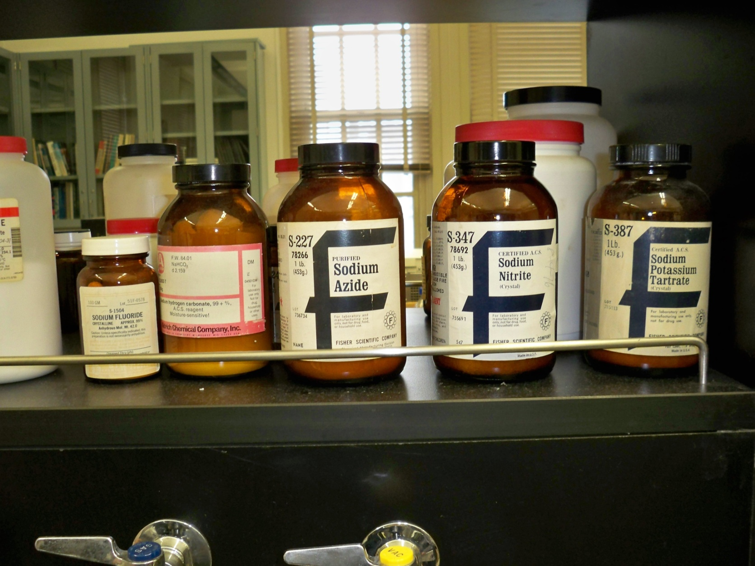
What were some of the findings of the CUNY environmental audit?
What’s wrong with this picture?
Oxidizer (NaNO2) stored with organics

Slide 41
What were some of the findings of the CUNY environmental audit?
What’s wrong with this picture?
Unlabeled (waste? reagent? sample?) container

Slide 42
What were some of the findings of the CUNY environmental audit?
What’s wrong with this picture?
Al-foil used as container caps
Tubing does not make a good seal with bottle
Tubing does not make a good seal with waste containers

Slide 43
EPA Inspections
Colleges and Universities have always been subject to EPA regulations, but have been inspected by EPA only since the mid-1990s
CUNY-EPA Audit Disclosure agreement, 2005-2010
EPA agreed to not audit CUNY campuses, but CUNY EHSRM must perform environmental audits
Most senior colleges have been inspected by EPA by October 2011
EPA expected to continue with inspections at CUNY

Slide 44
EPA Inspections
Lehman College has not yet been inspected by EPA
EPA focus: hazardous waste, chemical inventory issues
At other colleges (CUNY and others), issues of laboratory housekeeping have been cited

