Slide 1
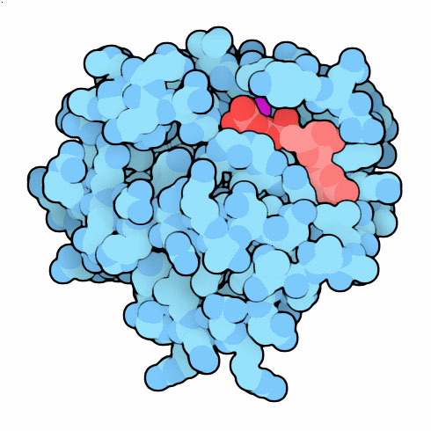
Modeling the Effects of Mutants and Drugs on the Ras Signaling Pathway
RuleBenders
Gianluca Arianna
Lyle Kingsbury
Piotr Gauza
Lehman College CMACS Workshop, 2014
Notes:
http://www.biochemsoctrans.org/bst/019/0432/0190432.pdf

Slide 2
Self-Sufficiency is a Hallmark of Cancer
Uncontrolled cell proliferation
Cells acquire ability to sustain growth without external growth queues (IGF, PDGF, etc)
MAPK (Ras-Raf-MEK-ERK) Pathway
The gene encoding Ras isoforms is mutated in many human cancers

Slide 3
Normal Ras Pathway becomes self-sufficient → uncontrolled activation of proliferation program
Ras-MAPK Pathway
Notes:
http://www.lehman.edu/academics/cmacs/documents/RasMutationsInCancer.pdf
Isoforms vary in their localization and their targeting domain and they are sent to different parts of the cell at varying concentrations. But they can all respond to the same signals and have homologous function. K-Ras is the more implicating protein and the one we examine here.

Slide 4
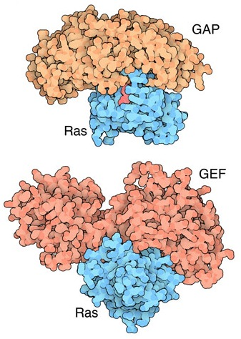
Ras Activation: Guanine Nucleotide Exchange
Ras (Rat Sarcoma) - Small GTPase protein
Active only in GTP-bound form
Activation through facilitated
nucleotide exchange from
GDP → GTP via GEF (SOS)
Self-regulates via hydrolysis of
GTP → GDP – partially
dependent on GAP (RASA1)

Slide 5
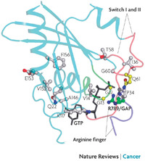
G12V/G12D Ras Mutations
Mutations to Ras gene destabilize GAP binding and diminish Ras-GAP affinity
Reduced GTP → GDP hydrolysis rate
Overactive Ras^{GTP} → MAPK/Proliferation

Slide 6
Prenylation
After transcription, transferase enzymes modify membrane-bound proteins with either a farenyl or geranyl-geranyl lipid moiety.
This prenyl group facilitates the protein’s incorporation into the plasma-membrane and subsequent interactions with other membrane proteins.
Salirasib, farnesylthiosalicylic acid – disrupts Ras prenylation and membrane association
Notes:
http://en.wikipedia.org/wiki/Prenylation
http://www.annualreviews.org/doi/pdf/10.1146/annurev.bi.65.070196.001325
The Ras Inhibitor Farnesylthiosalicylic acid disrupts the spatiotemporal localization of active ras: a potential treatment for cancer – rotblat, ehrlich, haklai and kloog

Slide 7
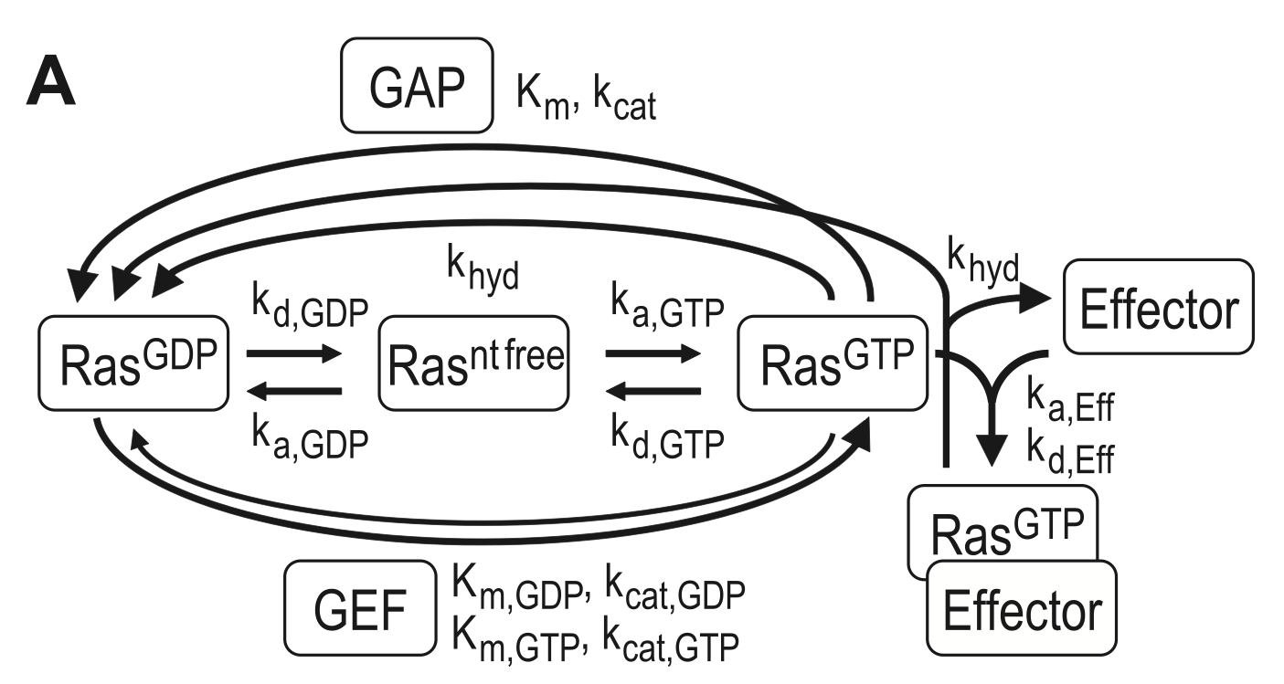
The Model Pathway

Slide 8
Fixing Mutant k_{cat}

Slide 9
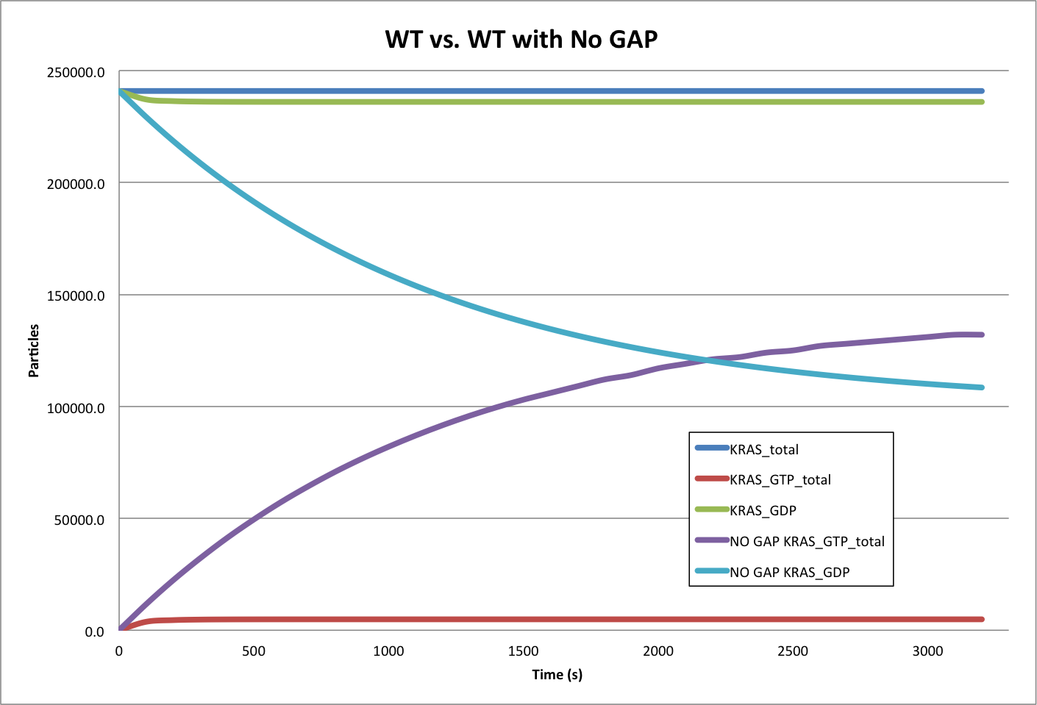
Model Accuracy
7 Mass-Action Reactions
7 Mass-Action Reactions2

Slide 10
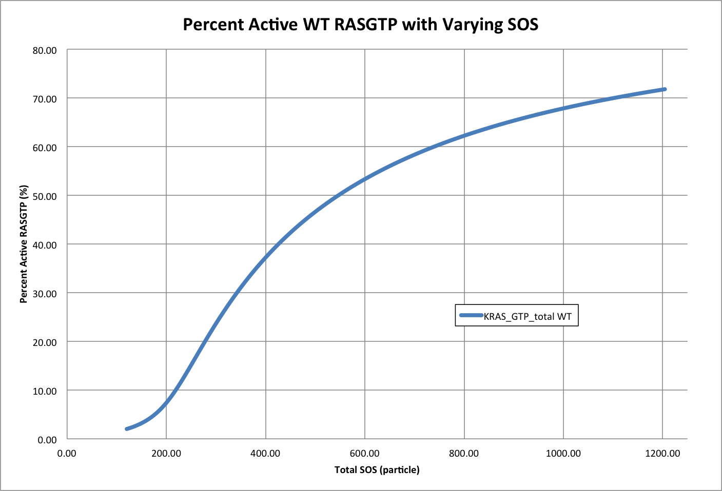
Effect of Varying SOS

Slide 11
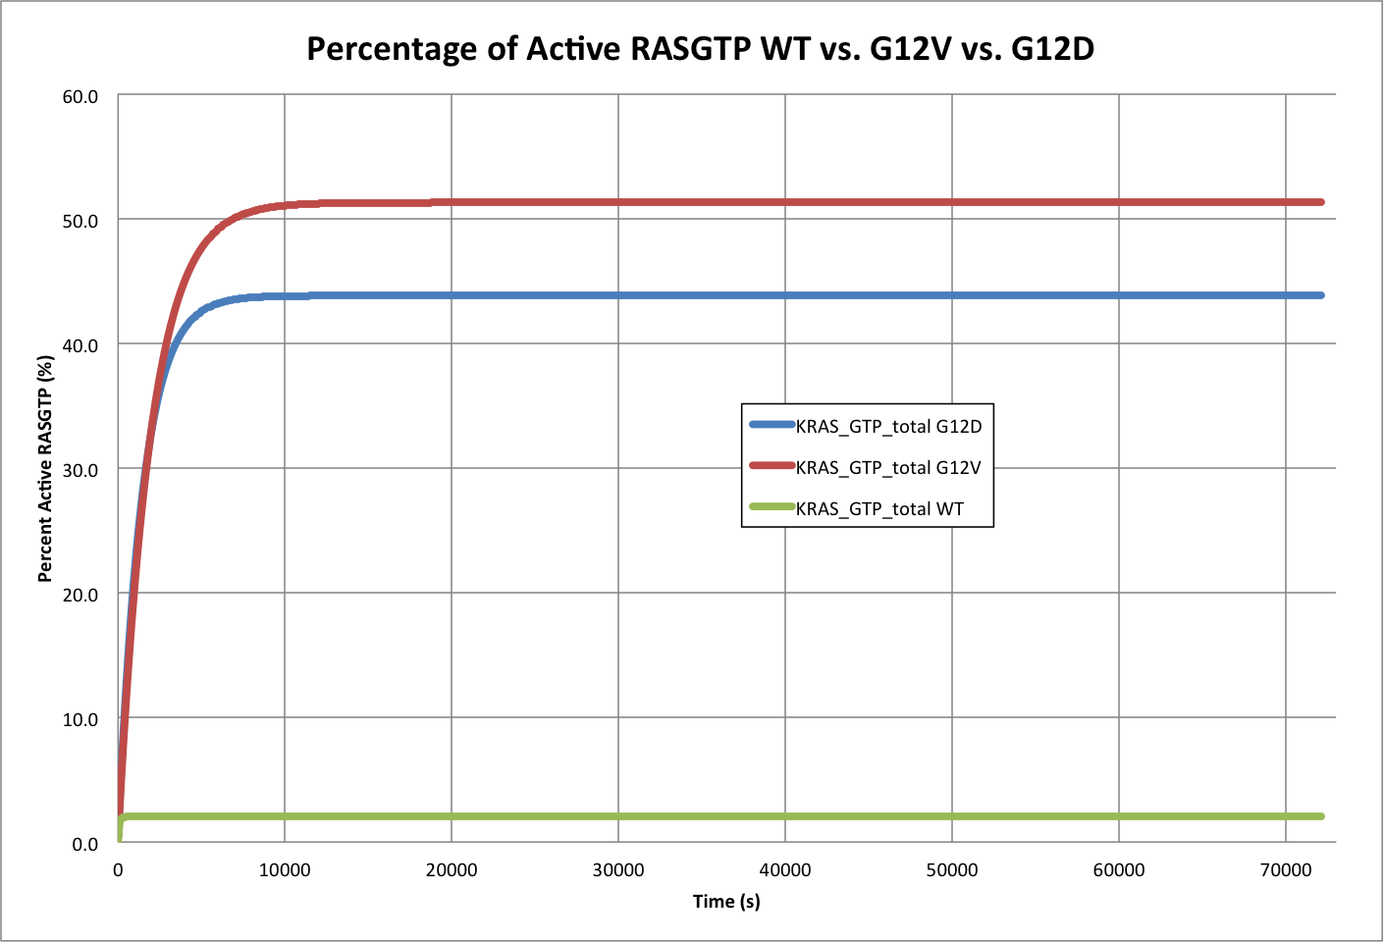
Mutant Effects on Active Ras^{GTP}

Slide 12
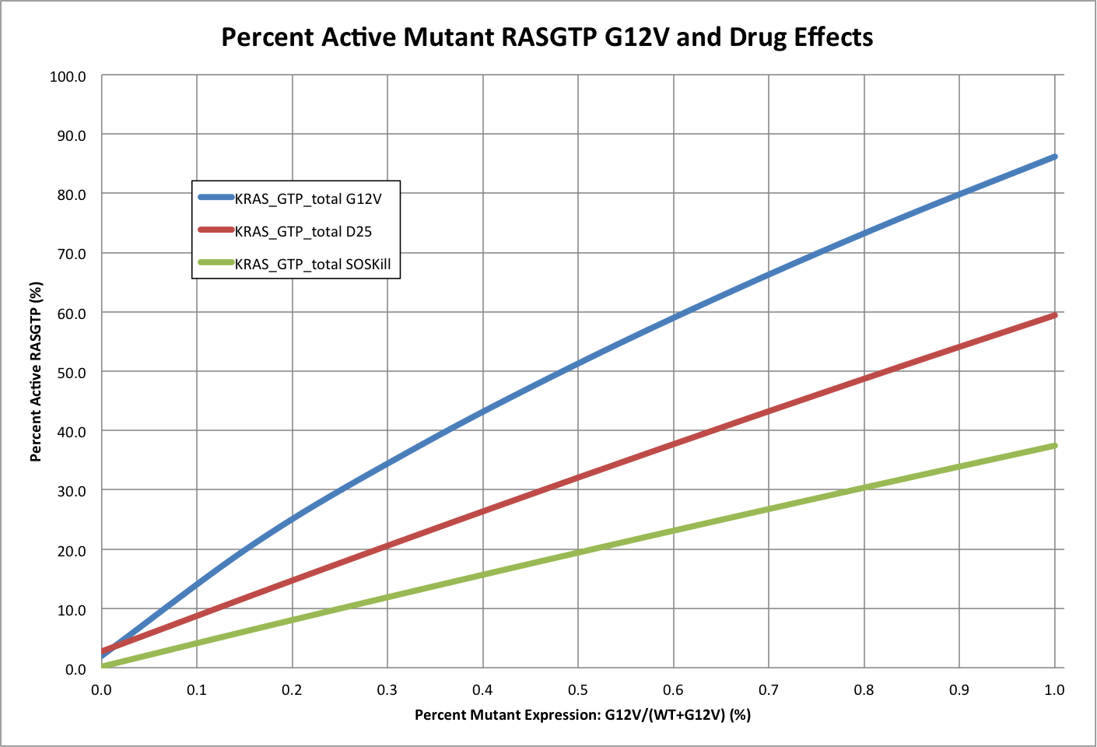
Drug Effects on Mutant Ras^{GTP}

Slide 13
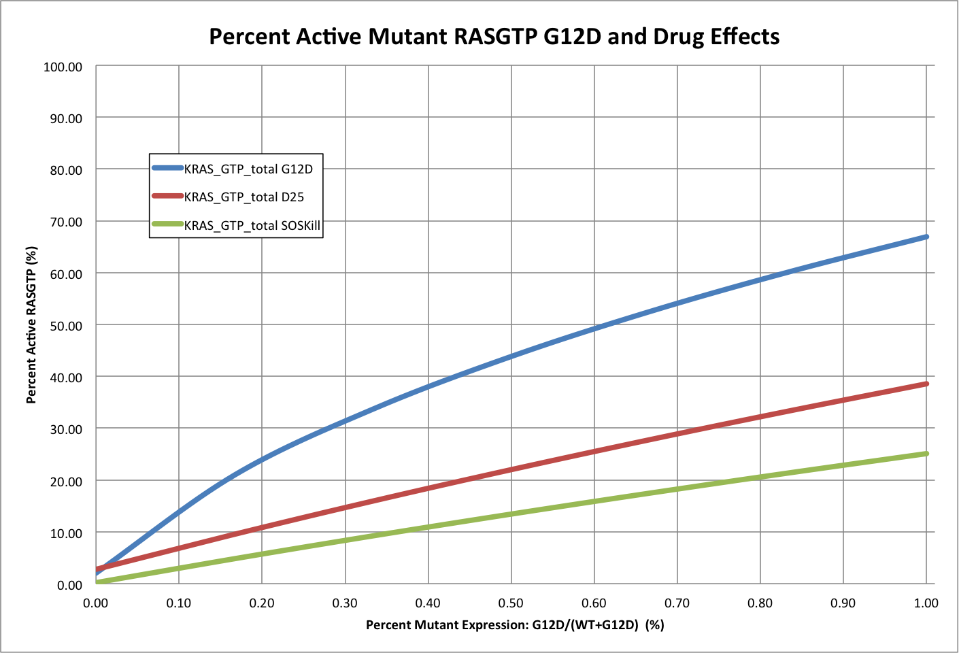
Drug Effects on Mutant RAS^{GTP}

Slide 14
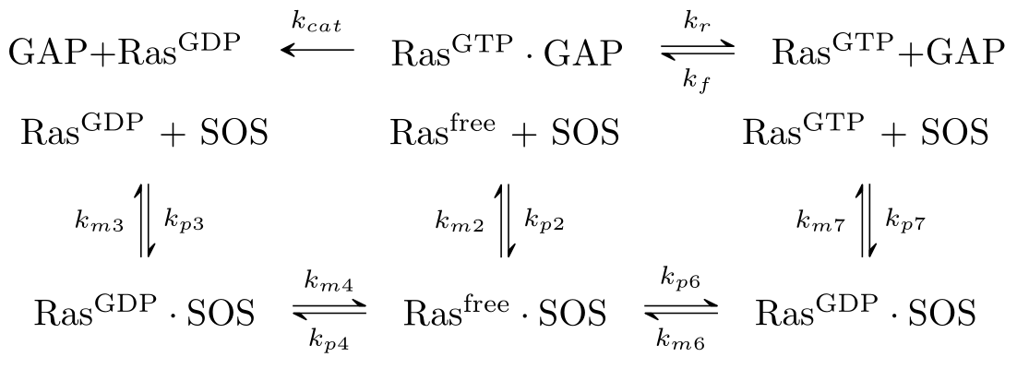
7 Mass-Action Reactions

Slide 15
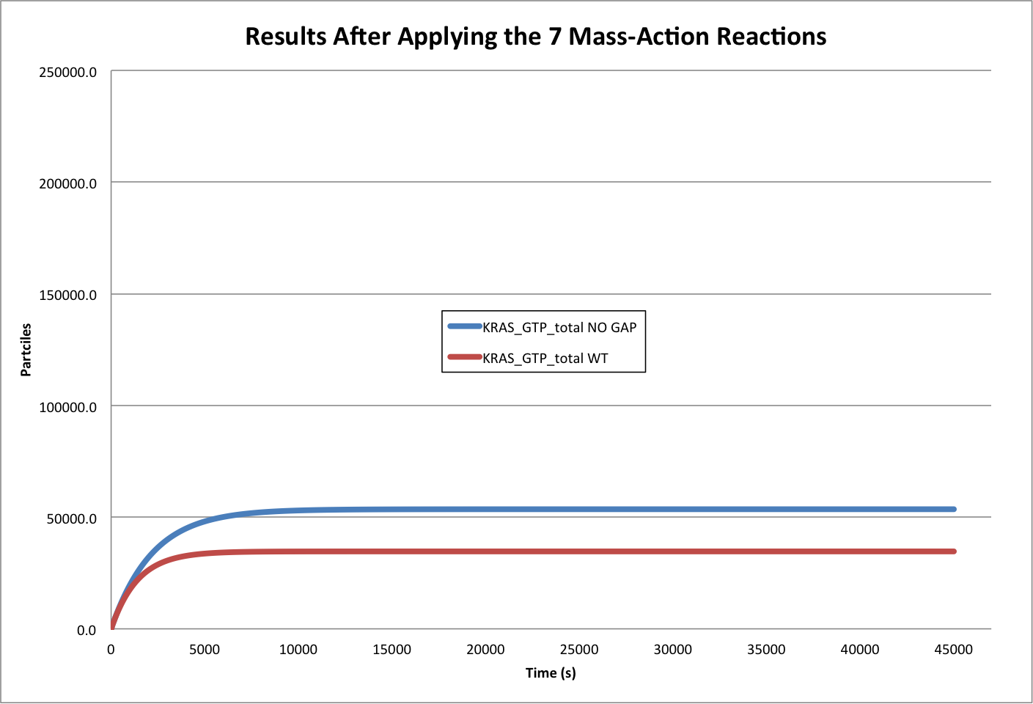
Modeling the 7 Mass-Action Reactions
Model Accuracy

Slide 16
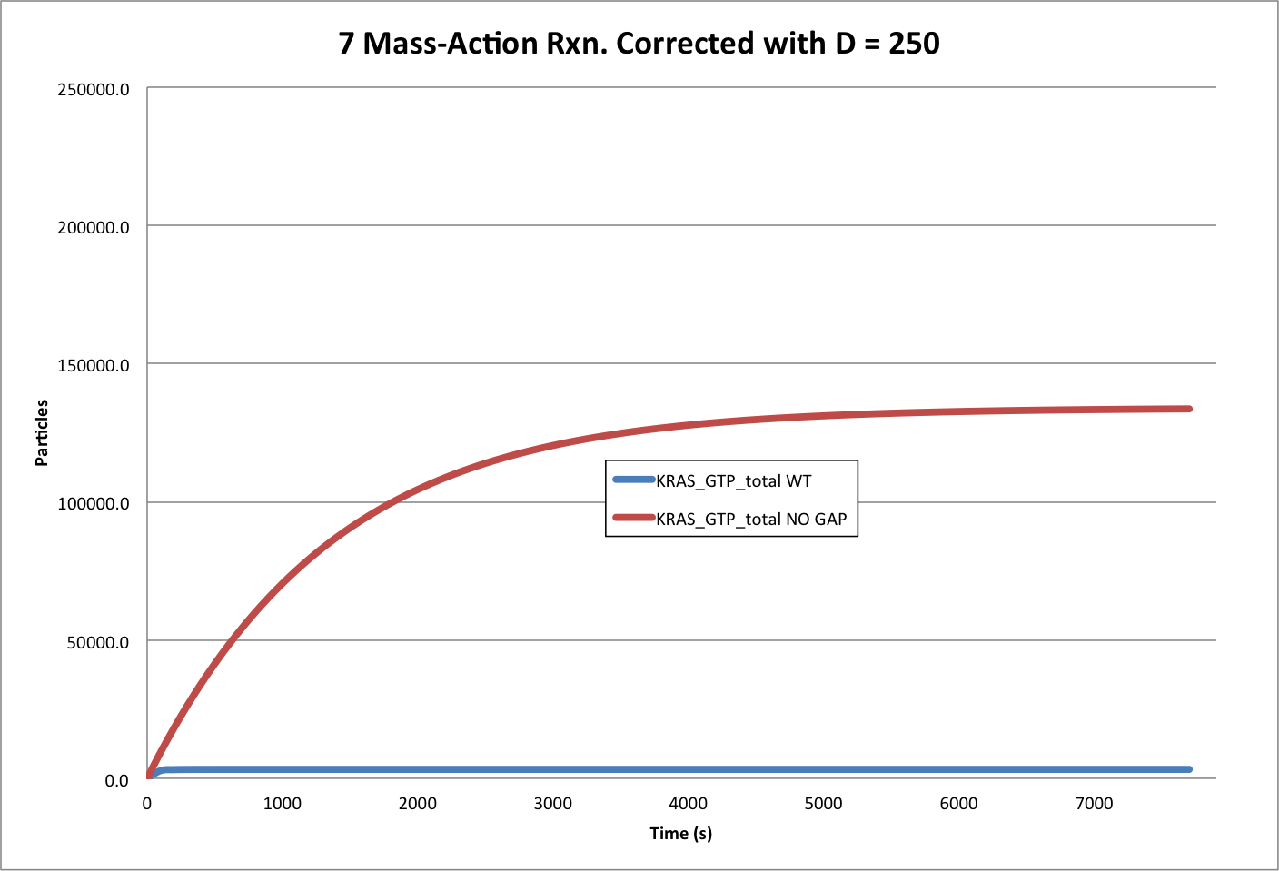
Modeling the 7 Mass-Action Reactions

Slide 17
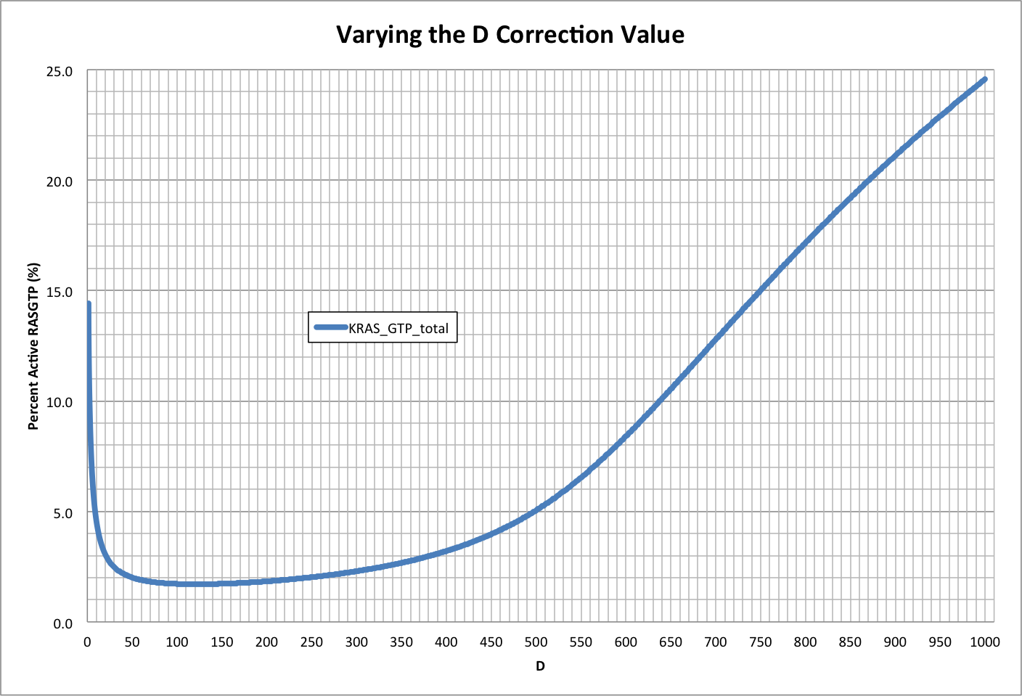
Varying D

Slide 18
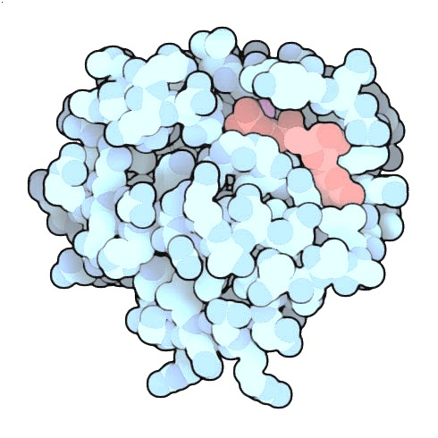
Acknowledgements
Nancy Griffeth
Naralys Batista
Jim Faeder
Stephen Redenti
DAN, Random, KScience, Modelers

Slide 19
Questions?

