Slide 1
The Joy of Computational Biology
Nancy Griffeth
Notes:
This is a personal view, why I think it’s exciting and fun

Slide 2
Outline
What will we be doing
Why I think computational biology is fun

Slide 3
Subject Matter
Workshop Information
Understanding how electrical activity in the heart relates to atrial fibrillation

Slide 4
Schedule
Workshop Information>Schedule
This week: Introductory lectures (Staff)
Next week: Advanced lectures (Fenton)
Third week: Projects
Last two days
Team presentations
Final visiting lecture

Slide 5
Pedagogical Approach
Workshop Information>Pedagogical Approach
Collaborative
Questions are always welcome
Discussion is encouraged!
Scribe to record unanswered questions
Problem-oriented:
Hodgkin-Huxley warm-up
Spiral waves

Slide 6
Pedagogical Approach
Workshop Information>Pedagogical Approach
Interdisciplinary team oriented
At least 1 biology expert
At least 1 computer science expert
At least 1 math expert

Slide 7
Speaking of Interdisciplinary…
Workshop Information>Pedagogical Approach
xkcd.com
Notes:
Mathematical jokes…
An engineer, a physicist, and a mathematician…
Three people (an engineer, a physicist and a mathematician) are staying in a hotel while attending a technical seminar. The engineer wakes up and smells smoke. He goes out into the hallway and sees a fire, so he fills a trashcan from his room with water and douses the fire. He goes back to bed. Later, the physicist wakes up and smells smoke. He opens his door and sees a fire in the hallway. He walks down the hall to a fire hose and after calculating the flame velocity, distance, water pressure, trajectory, etc. extinguishes the fire with the minimum amount of water and energy needed. Much later, the mathematician wakes up and smells smoke. She goes to the hall, and exclaims, 'Ah, a previously solved problem' and then goes back to bed.

Slide 8
General Learning Objectives
Workshop Information>Pedagogical Approach
Understand what excitable systems are
Understand how chaotic behaviors arise in excitable systems
Learn to function on interdisciplinary teams
Investigate some research problems
Meet new people and have some fun!

Slide 9
Specific Learning Objectives
Workshop Information>Pedagogical Approach
Learn what action potentials are, how they arise in cells, how they are propagated in cardiac tissue
Understand how the propagation of action potentials relates atrial fibrillation
Learn to understand models in the form of differential equations
Create computer-processable models of cardiac cells
Simulate their behavior
Investigate their properties
Project: Study formation of spiral waves of action potentials in cardiac tissue

Slide 10
Questions or Discussion?

Slide 11
What’s I like about comp bio
Biology matters!
Computational techniques help us understand biology
Cells act a lot like computers
Cells make binary choices
Cells have modular parts
Different kinds of cells share the same mechanisms
Lots of good movies on-line

Slide 12
Computational techniques
Organize data
Describe behaviors as a whole
Simulate behaviors
Bridge gaps where data is missing
Suggest hypotheses

Slide 13
Example 1: Cardiac Cells as Circuits
I(t)
g_{K}
g_{Na}
g_{L}
C_{M}
K+
E_{K}
E_{Na}
E_{L}
Notes:
Everybody knows that cells reproduce themselves by dividing in two, and preparatory to this they have to replicate DNA, which contains the instructions for the behavior of the cell. The cell goes through various phases in its cell cycle – you’ll see more later, right now let’s just look at mitosis (the M phase) which is the actual splitting. Entry to and exit from the M phase is controlled by a protein called cyclin (so named because its concentration in the cell – the amount of cyclin in the cell – was observed to “cycle” or oscillate from low to high and back over and over again.

Slide 14
Propagation of electrical signals across cardiac tissue
Normal action: what an electrical signal propagated across cardiac tissue should look like
Spiral wave: what a disrupted electrical signal might look like
Notes:
A simple model incorporating various things that have been experimentally observed demonstrates that cyclin can oscillate in a way that lets it serve as a kind of clock for the cell. So creating the model and using it to simulate cell behavior helped us verify that there is a mechanism involving cyclin that helps account for repeated cell division. This is also one way in which cells are rather like computers.

Slide 15
Example 2: Protein Production
Transcription
Translation
Figure from wikipedia article on the central dogma
Transcription
Notes:
Formulated by Frances Crick (one of the “double helix” discoverers, ie, he explained the structure of DNA)
Movie
Jump to 0:50
One of the great things about computational biology (and biology in general) is millions of GREAT videos!!

Slide 16
Protein Production
Wiring diagrams
Negative autoregulation: a protein represses its own production
Provides a quick increase to a robust level
Notes:
Negative feedback loop
This is a simple negative feedback loop, We’ll see a negative feedback loop as a component of a much more complex system; but I told you, biological systems, like computer systems, are modular!

Slide 17
Protein Production
cAMP signals absence of glucose
cAMP activates X
X binds to the DNA promoter, but is not enough by itself to start arabinose metabolism
X promotes transcription of Y; arabinose activates Y
X and Y together binding to the DNA promoter results in production of the enzymes that metabolize arabinose
Figure from Alon, “An Introduction to Systems Biology”
Notes:
Proteins are the workers of the cell, they do things like consume sugars to make energy. By producing a given protein, the cell can initiate work of a chosen sort. For example, consume glucose to get energy. Or alternatively, consuming another sugar to get energy. This requires decision-making
Note that we actually get a circuit here: NOT glucose (cAMP) AND Arabinose signals activate transcription factors that promotes transcription of enzymes that metabolize arabinose

Slide 18
What triggers activation of transcription factors?
An external signal (molecule) arrives
Binds to a receptor
Changes in the receptor cause internal actions…
Which cause cascading actions
Notes:
This is the central focus of the workshop, signaling pathways

Slide 19
Example 3: Regulating cell growth, proliferation, and differentiation
Notes:
A crucial signaling pathway is the Epidermal Growth Factor pathway, which controls cell proliferation. At the DNA end of this would be production of the required proteins, but at the cell membrane end is a change to the cell’s environment (maybe the arrival of some hormones!)
You’re going to work on this pathway as part of your project later on in the workshop.

Slide 20
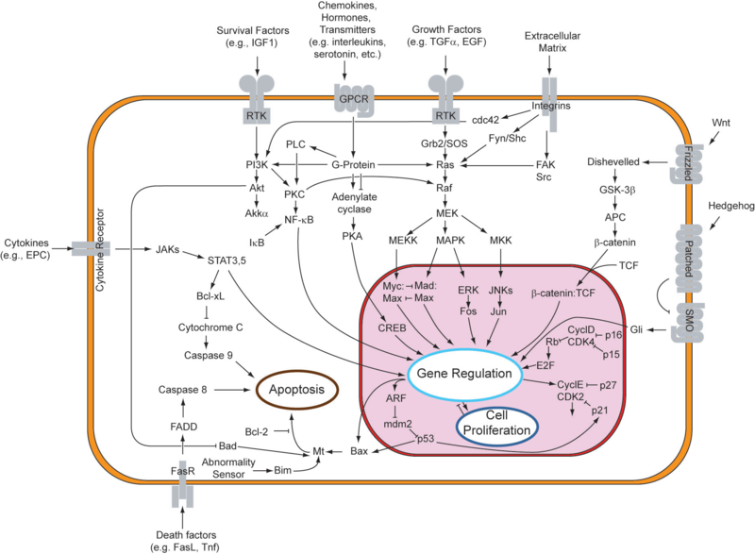
Example 4: Cell as Information Processor
http://en.wikipedia.org/wiki/Cell_signaling
Notes:
Think of this as a program insstead of a cell. Given this, it seems like we should be able to describe everything the cell does, right?
No – problems:
This is only a guess, based in part on observations but also on guesses. Also some observations reported in the literature may be wrong.
This is incomplete, it’s just what we’ve found so far – even if it was 100% correct, there’s more.
If these are statements in a language, we don’t entirely understand the language – we have seen bits and pieces of how the proteins interact with each other, but experimentation is hard.
So we have part of a program, in a language we don’t entirely understand, and we’re trying to bootstrap from this to understanding the whole program.

Slide 21
Example 5: Protein degradation
Ubiquitin
Tags proteins for destruction
Like garbage collection!!

Slide 22
Research Problems
Atrial Fibrillation: alleviating the effects or curing the problem
Computational complexity: how can we simplify the models enough to make them tractable?
Notes:
More honest to say, improve understanding of signaling pathways to help other researchers find cures to cancer. Hallmarks: it has been hypothesized that there are 6 or 7 hallmarks of cancer that we can detect in cells to determine the prognosis for the cancer. One is that a cell ignores signals that would limit proliferation – another is that it learns to signal other cells to proliferate. This explains why we are interested in signaling pathways,.

Slide 23
Relationship to atrial fibrillation
Electrical activity in the heart becomes chaotic in atrial fibrillation
Modeling the electrical activity helps us to understand how it develops
Modeling can help us develop techniques or devices to prevent or alleviate it
Notes:
Hallmarks of Cancer paper

Slide 24
Simplifying models
Computationally complex
Modular?
Course-graining
Need subsystems with behavior we can characterize

Slide 25
What you will learn…
How action potentials work
How action potentials relate to electrical activity in the heart
Modeling with differential equations
High-level view of how models can be “solved” numerically
How spiral waves and chaotic activities start in cardiac tissue

