Slide 1
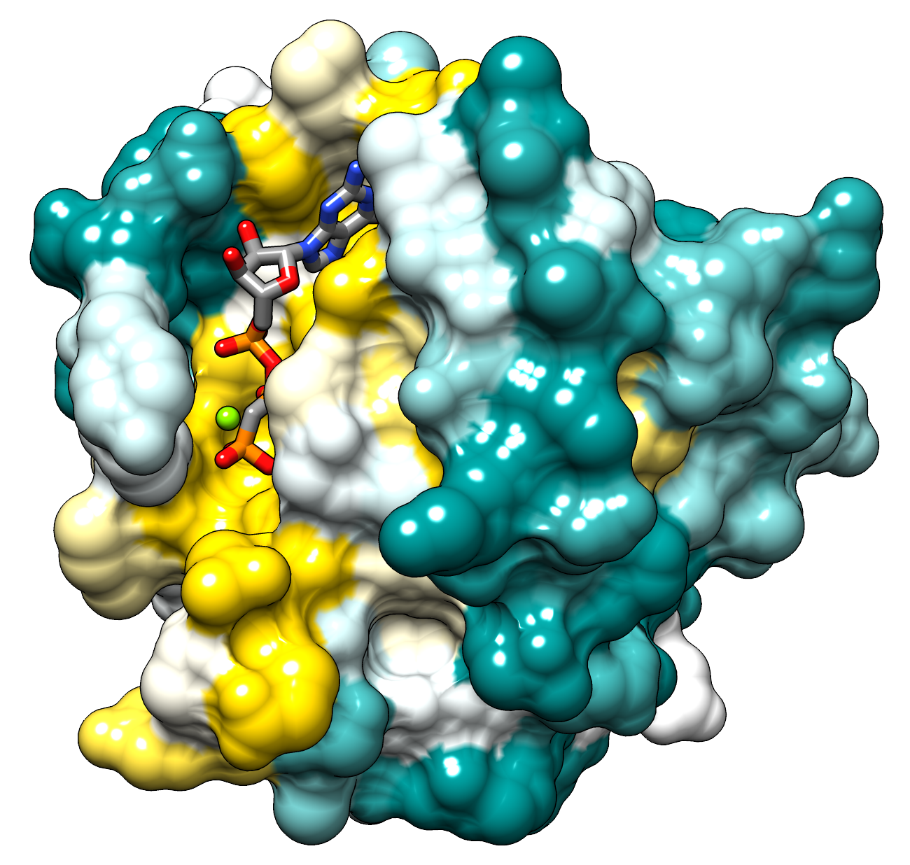
2014 NSF-CMACS Workshop on Cellular Signaling Pathways
Extending The Network Analysis of Oncogenic Ras Activation In Cancer (Stites, et.al.) Model With Positive Feedback From The Allosteric Binding Of Ras To The SOS GEF Complex.
Group DAN
Dylan Sun
Alessandro Rosa
Neno Fuller
Wikipedia

Slide 2
Shape In Biology
https://www.gameinformer.com/blogs/members/b/subsaint_blog/archive/2013/06/14/the-push-towards-digital-distribution.aspx
“Structure and Function are Correlated at All Levels of Biological Organization” – Campbell Biology, Ninth Edition
In Biology, Shape Is Everything
Notes:
In Biological systems, form often determines the function of a given structure.
The shape, or conformation that a Molecule takes will often determine whether or not it can participate in a given reaction or the rate at which the reaction will proceed.
A molecular interaction which causes a change in the shape of a molecule will often alter the functionality of that molecule.
Molecules such as enzymes which were inactive can be activated by the binding of another molecule, which alters the enzymes shape to its active form.

Slide 3
Feedback Mechanisms
“Feedback Mechanisms Regulate Biological Systems” – Campbell Biology, Ninth Edition
Notes:
The schematic on the left shows a hypothetical negative feedback loop.
A negative feedback loop works by slowing down or inhibiting the process taking place within the cell, usually as a response to an accumulation on of one of the products within the system.
In the hypothetical model, we see that the accumulation of the product of the process, D limits enzyme 1 from transforming the starting substrate, A, into product B.
This results in the process being turned off so that D is not produced,
Negative feedback mechanisms tend to be the most prevalent form of the feedback model in biological systems.
The schematic on the right represents a positive feedback loop.
A positive feedback loop works by speeding up the production of its end product.
It is this type of mechanism that we see at work when either RasGDP or RasGTP binds to the allosteric pocket of the the Sos complex, which then binds to a separate free RasGDP molecule to catalyze the reaction that replaces GDP with GTP

Slide 4
Ras+SOS GEF Positive Feedback Loop
Notes:
This illustration of the SOS Guanine Nucleiotide Exchange Factor complex shows the three possible states which SOS can bind to Ras GDP to catalyze the GDP to GTP transfer reaction.
The First Reaction type, SOScat is where Ras, bound to a Guanosine Diphosphate nucleotide binds to the Guanine Nucleotide Exchange Factor pocket with an empty allosteric pocket.
Experimental data shows us that the rate of catalyzation is very slow for this reaction, to the point where the reaction does not produce appreciable levels of active RasGTP from the RasGDP substrate.
The second conformation, SOScatGDP, is where a RasGDP molecule binds to the allosteric pocket of the SOS complex, causing a shape change and allowing the SOS + RasGDP complex to catalyze the Exchange reaction at a rate five times faster than the SOS enzyme not allosterically bound to a RasGDP molecule.
In the case where the SOS complex is able to bind allosterically to an active RasGTP molecule, a 75 fold increase in the rate at which the SOS GEF complex can catalyze the exchange of GDP to GTP in an inactive Ras molecule.
This increase in the rate at which SOS GEF Catalyzes the exchange reaction is an example of a positive feedback loop.
SOS bound allosterically to a RasGTP is more efficient at catalyzing the exchange reaction
The increased reaction rate means that RasGTP is able to be produced more quickly that when SOS is in the other two conformations.
As RasGTP is produced more quickly, there are more active RasGTP molecules available to Complex allosterically with SOS , allowing for the production of RasGTP more quickly.
Eventually either a saturation point will be reached or a steady state with the degradation of RasGTP will be achieved.

Slide 5
BioNetGen Reaction Rules For Allosteric Feedback Loop
Positive feedback loop:

Slide 6
Complexation Reaction Of SOS-GEF With Ras
RasGTP Allosterically Binds To SOS, Improving Its Catalytic Efficiency
Notes:
As can be seen in the graph, most of the SOS is allosterically bound to either RasGDP or RasGTP. Very little of it remains “free” and not-allosterically bound. You can see that there is apparently a preference for SOS to allosterically bind to RasGTP over RasGDP.

Slide 7
Results Of Guanine Nucleotide Exchange Factors Transfer Reaction With Allosteric Feedback Loop
Original Model Based on Reaction Rates in Stites Paper
Produce RasGTP more quickly than positive Feedback Model
Positive Feedback Model
Initial reactions catalyzed at the relatively slower SOS•RasGDP Reaction Rate
As number of RasGTP particles increases, the reaction is catalyzed and the relatively faster SOS•RasGTP Reaction Rate
Positive Feedback Model shows that reaction rate without feedback in Original Model overestimates the production of RasGTP in the initial stages of signal transduction
Notes:
Connect to the next slide
ALESSANDRO NOTE: NOT THRILLED WITH THE CHANGES I MADE TO THIS SLIDE… IT IS TOO WORDY. ANY SUGGESTIONS ON WHERE TO CUT?

Slide 8
Parameter Scan Comparison of Models
Parameter Scan of the Original Model without the Positive Feedback Loop At high SOS levels the ratio of Ras-GTP to Ras-GDP increases rapidly
Parameter Scan of the Positive Feedback Model Ratio of RasGTP to RasGDP changes at a slower rate
Notes:
Now, as we noted before with regards to the difference models; we see more pronounced in these graphs.
Due to the fact that initially when we have the rasGTP/ ras GDP conversion, the rate for the SOS/Ras GDP catalyzes as a slower rate than the SOS/RDP rxn.
So for the first graph as we increased the amount of SOS, then
The purpose of this paramteter scan is to show the effect of increasing the concentration of SOS in the cell system. As you can see from the results, at 0 or very low concentrations of SOS, the pathway is essentially inactive; almost all of the RAS in the system is in the inactivated form, where it is bound to GDP rather than GTP. As the concentration of SOS increases, you can see the pathway of RAS becoming more active, and after a certain point, the amount of activated RAS (RASGTP) is much higher than the amount of inactivated RAS (RASGDP). This trend is the same for both the original model that did not model the positive feedback loop, and for our new model, although the SOS seems to have less of an effect on the positive feedback model. Apparently much less SOS is necessary to activate the nonpositive feedback loop.

Slide 9
Effect Of Rules For Uncatalyzed Removal Of Guanine Nucleotides From Ras On Positive Feedback Model
BioNetGen Reaction Rules for the Uncatalyzed Removal of Guanine Nucleotides from Ras

Slide 10
Issues Of High SOS Concentrations On Positive Feedback Model
Notes:
A problem occurs with the positive feedback model at very high concentrations of SOS. Because we have no mechanism through which RAS can unbind from the allosteric site of SOS, at very high concentrations of SOS, a lot of the RASGTP ends up being “trapped” by the allosteric pocket of the sos. You can see this in the graph where the amount of RASGTP and RASGDP does not add up to total RAS.
At lower concentrations of SOS this is less relevant.

Slide 11
Comparison of Model Runs Based On Wild Type Ras Gene
Notes:
This is the cell when it has not been turned on; the sos level is very low and so you see that no rasgtp is being produced.

Slide 12
Adding GAP – Insensitivity Mutant RAS to Positive Feedback Model
A relatively common form of mutant is G12V RAS
Ras binds to GAP but GTP is not hydrolyzed
This mutation cause Ras to remain in its active form when it is activated and leads to the overproduction of proteins which lead the cell into mitotic division
The loss of regulatory control of Ras activity is one of the steps which leads a cell towards cancer.

Slide 13
SOS level arbitrarily chosen: 5000
Parameter Scan of Effects of GAP Insensitivity Mutation
SOS level arbitrarily chosen: 5000

Slide 14
Comparison of Model Runs Turning Off GAP – Mediated Hydrolysis
Turning off GAP – Mediated Hydrolysis in the models is similar in effect to the GAP Insensitivity Mutation of the Ras gene; a key mutation that turns Ras into an Oncogene
Notes:
This is apparently an alternate way for activating cekk

Slide 15
The Ras Signaling Pathway
Notes:
At every level of a cellular signaling pathway, molecular interactions lead to conformational changes that activate molecules within the pathway, giving rise to a specific process in the cell.
The signaling pathway shown is a simplified model of the Ras mediated signaling pathway.
An Epithelial Growth Factor molecule, known generically as a ligand binds to a receptor which it has specificity for and causes a conformational change in the receptor allowing it to produce a signal that the cell will respond to.
The receptor, in this case a membrane-bound enzyme Receptor Tyrosine Kinase (RTK), changes conformation through the binding of its ligand and is activated when two RTK’s join together to form a dimer.
Kinases are enzymes which catalyze the transfer of phosphate groups from other molecules.
Once active, the RTK dimer is able to accept a phosphate group from ATP onto Tyrosine residues in the Tyrosine Kinase domain of the molecule.
The RTK is now able to activate relay proteins that begins a phosphorylation cascade and leads to a cellular response.
One of the important relay molecules in the Cell cycle stimulating pathway is the Ras G protein. Produced from the highly conserved Rat Sarcoma proto-oncogene, Ras is key not only to organism development, but can also be mutated to form an oncogene which can lead to uncontrolled cell growth and the formation of cancer in a multicellular organism.
Like all G Proteins Ras has an inactive state where it is bound to the Guanosine diphosphate nucleotide or an active state where it is bound to the Guanosine triphosphate nucleotide.
In its active form, Ras is capable of activating other protein kinases, which will activate transcription factors leading to the transcription of genes which encode for proteins that stimulate the cell cycle.
This pathway is important because activation of the Ras pathway will induce the cell to enter into the cell cycle. When critical mass is reached at each stage of the cell cycle, it will proceed to the next step in the cycle, eventually replicating through division.
When the Ras pathway is working properly, it is vital for organism development and tissue repair through activation of the the cell cycle.
When the Ras pathway is broken, as is the case with mutations that affect the ability of Ras to bind to GTPase-Activating Proteins (GAPs), it greatly reduces the rate at which Ras is able to Hydrolyze a phosphate group from GTP in order to deactivate itself. The hyperactive form of Ras can cause the overproduction of proteins leading to the cell entering into the cell cycle

Slide 16
Possible Bugs
Rate units and conversions
Model uses particles rather than concentrations
Rates taken from a variety of papers
Assumptions made
Concentration of SOS must be much lower than the concentration of Ras for Michaelis-Mentin equations to work
Unactivated SOS has no rate for converting RasGDP to RasGTP
SOS is equally likely to be activated by mutant Ras
Notes:
This is a list of things we weren’t too sure about in the model. If in the future you are looking at the model and encounter some issues, these possible bugs would be a good place to start.

Slide 17
Conclusions
Modeling specific components of a Signal Transduction Pathway provides insights into how a particular biological process works
A basic model of the process being investigated provides a foundation from which more detailed evaluation can be added onto, providing a more detailed view of the process
It is important to validate model results with experimental data to ensure that the model accurately reflects the modeled system
Different molecular interactions within the same pathway affect the efficiency of a molecules ability to catalyze downstream reactions

Slide 18
Conclusions
By not simulating the activation of the signal transduction pathway the model does not seem to accurately representing the signaling of a healthy cell
When Epithelial Growth Factor concentration decrease in the biological system, it is possible that the ligand would release from Receptor Tyrosine Kinase, deactivating it and shutting down the pathway
The cell can also endocytose the Receptor Tyrosine Kinase, turning off the signal transduction pathway
SOS inactivation/degradation will effect the concentrations of active Ras and thus the production of cyclins

Slide 19
Conclusions
While modeling Ras activation and degradation allows us to see the change in Ras concentration over time, the model does not take into account the activity of Tumor Suppressor molecules and their role in mediating the cell cycle
As The Hallmarks of Cancer paper by Hanahan and Weinberg shows, multiple errors need to occur within a cell in order for it to proceed towards cancer
While valuable in understanding one aspect of a cells journey down the path to cancer, modeling one aspect does not give the complete picture of the disease process within the cell
However, a reductionist approach can lead to an understanding of vulnerabilities within cancer that can be exploited by treatment options that target those particular areas

Slide 20
Suggested Extensions To Positive Feedback Model
Modeling the activation/deactivation of the Tyrosine Kinase Receptor and SOS recruitment to the plasma membrane would improve the overall accuracy of the model
Modeling SOS inactivation and degradation
Adding inhibitory molecules to the pathway to reflect the cell’s natural regulatory environment

Slide 21
Acknowledgements
Group DAN would like to thank:
The National Science Foundation for funding the Workshop
Dr. Griffeth for providing direction, support, and leadership
Naralys Batista for great guidance with Rule Bender programming and keeping us well caffeinated and functioning
Dr. James Faeder
Dr. Stephen Redenti
CUNY – Lehman College for hosting the 2014 NSF-CMACS Workshop

