Slide 1
CMACS 2013: Using The ten-tusscher model
Group 1- Anoopa Singh, Katarzyna Golec, Tova Neuberger

Slide 2
Wait…what are we doing?
Using a 12 variable model to simulate atrial fibrillations of the heart.
Parameters of importance were ion channels & their conductance.
Our variables were GNa [the conductance of the sodium channel] and GCaL [the conductance of the calcium leak channel]
Our variables allowed us to delve into the relationship between the action potential duration and the stability of a spiral wave…more on that later.

Slide 3
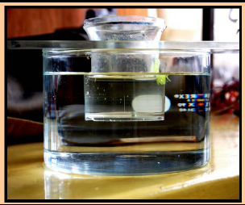
Excitable systems!
Like the saline oscillator!
Variables to vary: thickness, orifice size, saline solution concentration and area of smaller chamber

Slide 4
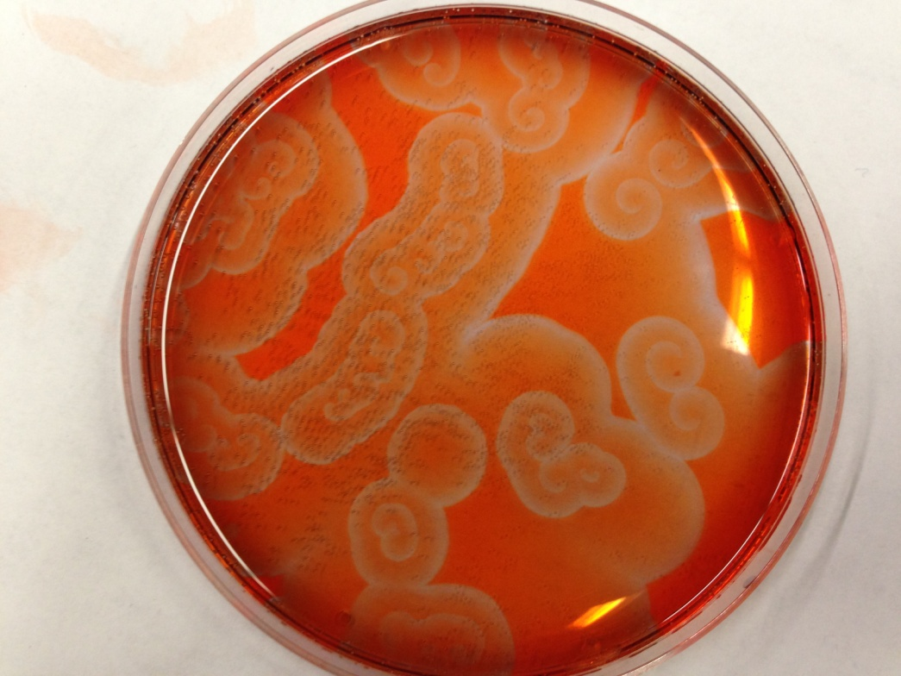
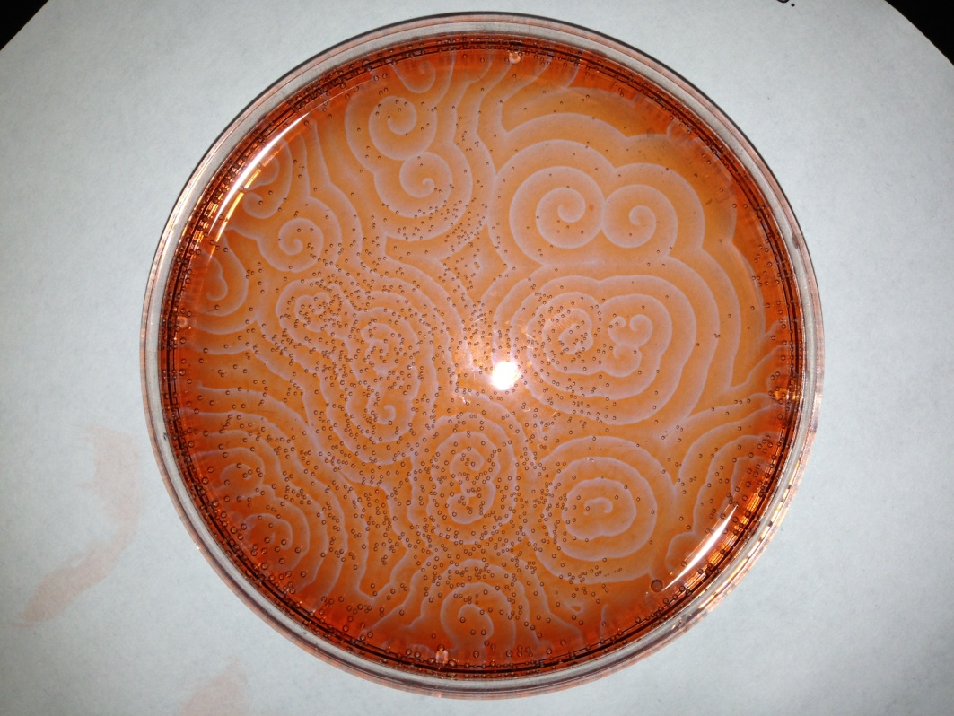
More Excitable systems
Belousov- Zhabotinsky Reaction

Slide 5
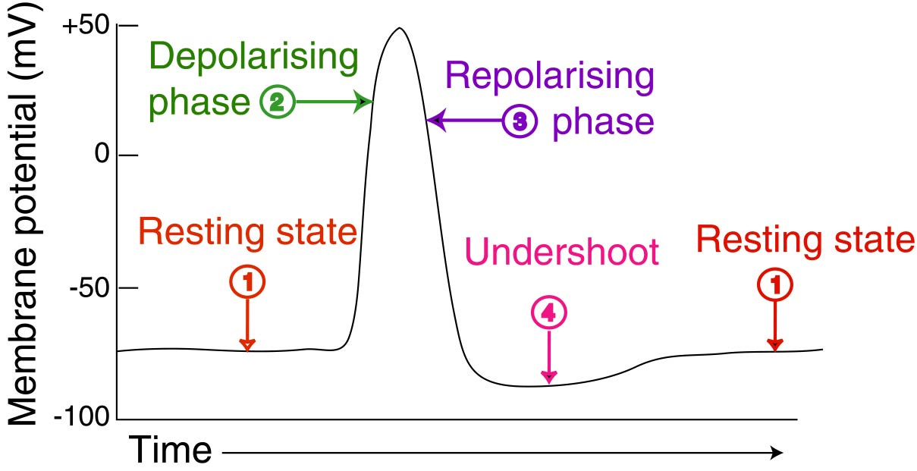
A word on action potentials: first, Neural
There are neural Aps as well as cardiac APs- an understanding of both is crucial

Slide 6
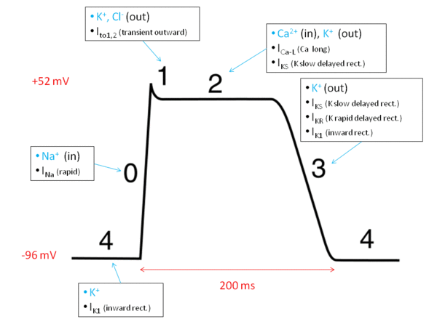
And more importantly, Cardiac

Slide 7
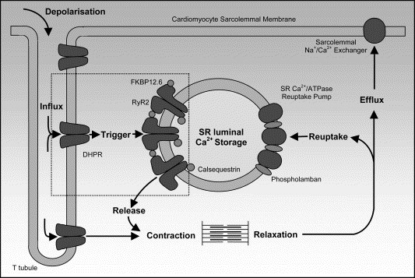
The importance of Sodium and calcium
Sodium: in cardiac cells, STARTS the depolarization. Without sodium, there would be no action potential. But with excess sodium, what happens?
Calcium: In cardiac cells MAINTAINS the action potential over time- is the major difference between neural and cardiac action potentials. Necessary because without calcium extending depolarization, the heart muscle cannot contract.

Slide 8
Results!

Slide 9
Click us!
someindividual.com/cmacs/group1_spirals.png
someindividual.com/cmacs/group1_paths.png
someindividual.com/cmacs/group1-2_paths.png

Slide 10
conclusions

Slide 11
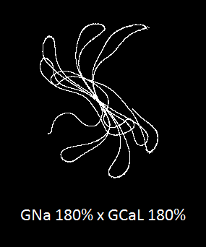
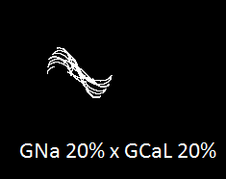
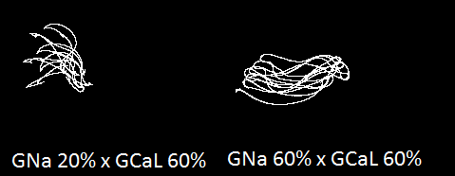
Tip trajectories get more chaotic when there is more sodium or calcium

Slide 12
During the second run, more than one tip trajectory appeared

Slide 13
Spiral Wave variations

Slide 14
MANY THANKS TO
Nancy Griffeth
Flavio Fenton
Robert Gilmour
Bard Ermentrout
Aron Wolinowitz
Charles Beard
Rachel Spratt
Daniel Packer
And of course,
Peter Valdez

Slide 15
Image Citations
http://www.google.com/imgres?um=1&hl=en&sa=N&tbo=d&biw=1016&bih=601&tbm=isch&tbnid=O2Mw6UOgtKL9iM:&imgrefurl=http://scienceblogs.com/clock/2007/02/08/physiology-regulation-and-cont/&docid=o_jXc1OqTKdqhM&imgurl=http://scienceblogs.com/clock/wp-content/blogs.dir/458/files/2012/04/i-91bc1a5f2d248f09ffed13e377b9c940-ActionPotential.jpg&w=1209&h=621&ei=T9MBUaXrHoW-9QSi3YFI&zoom=1&iact=hc&vpx=312&vpy=290&dur=3469&hovh=161&hovw=313&tx=84&ty=123&sig=105641550966841077453&page=1&tbnh=130&tbnw=253&start=0&ndsp=16&ved=1t:429,r:7,s:0,i:172
http://www.google.com/imgres?um=1&hl=en&tbo=d&biw=1016&bih=601&tbm=isch&tbnid=teI4IMA38Vi9rM:&imgrefurl=http://en.wikipedia.org/wiki/Cardiac_action_potential&docid=DaTJn-CVyoXvKM&imgurl=http://upload.wikimedia.org/wikipedia/commons/thumb/c/cb/Action_potential_ventr_myocyte.gif/600px-Action_potential_ventr_myocyte.gif&w=600&h=450&ei=YNMBUdHgM4is9ATG04HoCg&zoom=1&iact=hc&vpx=2&vpy=163&dur=2469&hovh=194&hovw=259&tx=78&ty=117&sig=105641550966841077453&page=1&tbnh=139&tbnw=174&start=0&ndsp=15&ved=1t:429,r:0,s:0,i:109
http://www.google.com/imgres?start=257&um=1&hl=en&sa=N&tbo=d&biw=1016&bih=601&tbm=isch&tbnid=yb9PHXwSrUFW8M:&imgrefurl=http://www.sciencedirect.com/science/article/pii/S0006291X04017723&docid=m-ejWdrDZfSGiM&imgurl=http://ars.els-cdn.com/content/image/1-s2.0-S0006291X04017723-gr1.jpg&w=533&h=357&ei=JtkBUeCnJrS30AG-wIFw&zoom=1&iact=hc&vpx=290&vpy=185&dur=5549&hovh=184&hovw=274&tx=228&ty=87&sig=105641
http://www.lehman.edu/academics/cmacs/documents/Lehman_day1.pdf550966841077453&page=13&tbnh=148&tbnw=220&ndsp=24&ved=1t:429,r:59,s:200,i:181
http://lehman.edu/academics/cmacs/documents/Lehman_day1.pdf

