Slide 1
Modeling the Frog Cell Cycle
Nancy Griffeth
January 13, 2014
Funding for this workshop was provided by the program “Computational Modeling and Analysis of Complex Systems,” an NSF Expedition in Computing (Award Number 0926200).

Slide 2
Goals of modeling
Knowledge representation
Predictive understanding
Different stimulation conditions
Protein expression levels
Manipulation of protein modules
Site-specific inhibitors
Mechanistic insights
Why do signal proteins contain so many diverse elements?
How do feedback loops affect signal processing?
Drug development
New targets
Combination therapies
Adapted from Jim Faeder’s presentation
Notes:
Blue are the things that are specifically relevant to the exercises we will do in the workshop

Slide 3
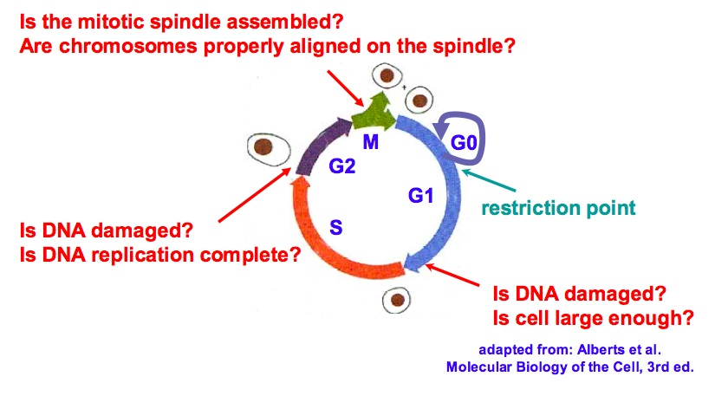
Eucaryotic Cell Cycle
Notes:
In general – not the frog, the general eukaryotic cell cycle.
Checkpoints
Kinetic proofreading – helps to enforce checkpoints. Uses different reaction rates to select out “bad” consequences from good ones – at a decision point, the bad proteins are more likely to exit a sequence of processing steps than the good ones. If the exit step is fast and the next step is slow, there’s lots of time for the bad stuff to exit.
Example: protein synthesis error rate is 1 in 10,000. That’s very good (not as good is the error rates in transmission over fiber though). Still, biological processes seem relatively sloppy next to digital ones – but maybe not!!
What happens if it fails a checkpoint? Apoptosis – cell should suicide. What if it doesn’t?

Slide 4
Predictive Understanding
Why is the cell cycle unidirectional?
Once a cell initiates mitosis, why does it never slip back into S or G2?
What controls the timing of cell cycles?
Notes:
A cell cycle can range in length from eight minutes (in fly embryos) to more than 24 hours (in adult mammals)?
Some questions that we’d like to be able to answer

Slide 5
Experimental Results
Synthesis and degradation of cyclin is all that is needed to drive cell cycle oscillations in frog egg extracts
A threshold amount of cyclin is required to drive an extract into mitosis
Useful behaviors
Positive and negative feedback
Bistability
Notes:
Why do we care about frogs – Conservation

Slide 6
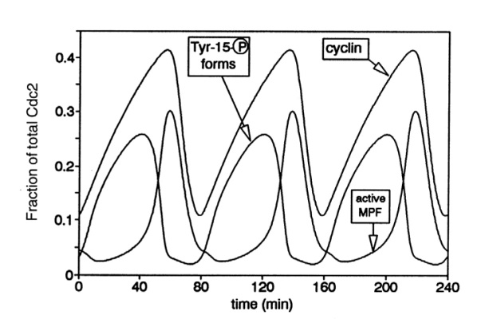
Observed Behavior of Cyclin and its Complexes
Pre
MPF
Figure 9 from Novak and Tyson, J. Cell Sci 106, 1993
Notes:
MPF stands for mitosis-promoting factor. It is a complex of cyclin and another kind of protein called Cdk. There are lots of cyclins and cdks, different ones associated with different phases of the cell cycle; in the case of MPF, we’re talking about cyclin B and cdk 1.
It has been observed that there’s lots of MPF around just before mitosis!
Cyclins and Cdks are regulatory proteins that control the cell’s progress through the cell cycle (Hartwell, Hunt, and Nurse won 2001 Nobel Prize for their discovery of their role.)
They form a cyclin/cdk complex, which is called MPF in one form and preMPF in another form.
Cdk’s are catalytic, but are inactive when not bound to cyclin. In fact, they are kinases. Let’s see what kinases are.

Slide 7
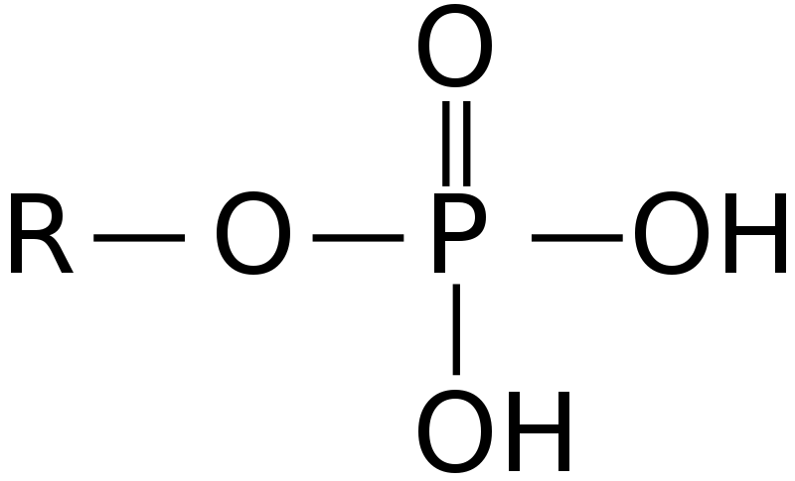
Some important concepts
Kinase:
an enzyme that transfers phosphate groups from molecules such as ATP to a specific substrate
Phosphorylation:
the process of transferring a phosphate group
Phosphatase:
an enzyme that removes phosphate groups
Notes:
Protein kinases are especially important for us, and throughout the workshop we will see instances of protein kinases transferring phosphate groups from one protein to another

Slide 8
Observed Behavior of Cyclin and its Complexes
Pre
MPF
Figure 9 from Novak and Tyson, J. Cell Sci 106, 1993
Notes:
Now the difference between MPF and preMPF is that MPF is singly phosphorylated (has a single phosphate group attached) whereas preMPF is doubly phosporylated.
It turns out that mitosis happens when MPF is at its peak and preMPF is low. So the second phosphorylation somehow deactivates the MPF from causing mitosis. This double phosphorylation happens almost immediately when Cyclin and Cdk form a complex, causing a delay from the time the cyclin starts increasing until the MPF starts increasing.
The question is, how can we explain this complicated behavior? What interactions of proteins could do this?

Slide 9
Quick Review: Chemical Reactions
2H₂+O₂ ➔ 2H₂O
Notation for chemical reactions:
Reactants
Products
Conservation
Thermodynamics
Can be bi-directional

Slide 10
Quick Review: Enzymes
S+E ➔ P+E
Catalytic reactions:
Substrate
Enzyme
Product
The enzyme enables the reaction
The enzyme is not consumed by the reaction

Slide 11
Enzymatic Reaction Rates
Enzyme Action:
Reaction Rate:
Notes:
Kcat is the maximum number of substrate molecules converted to product per enzyme molecule per second
Vmax = kcat * E0 is the maximum rate at which the reaciton takes place
Km (Michaelis constant) is the amount of substrate at half-maximum rate

Slide 12
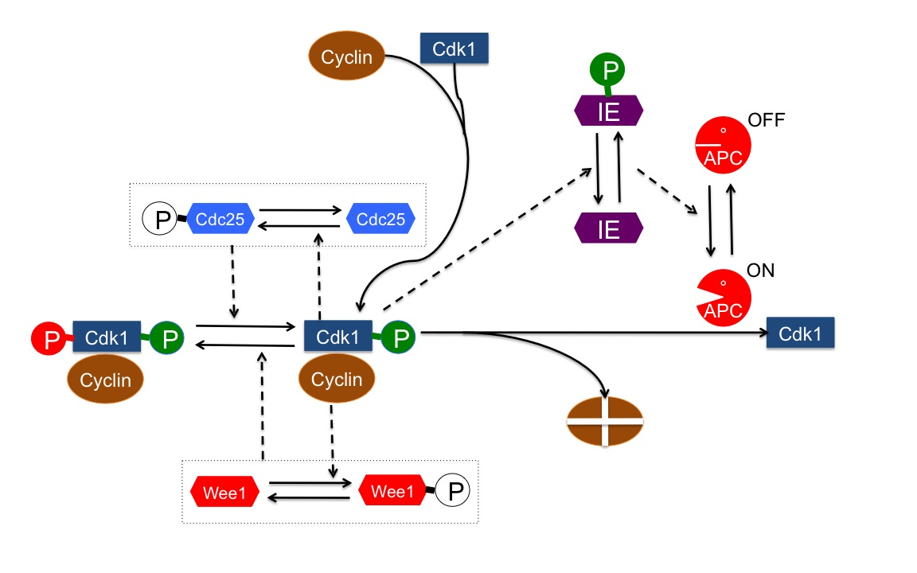
A model for cyclin B and mitosis in frog egg extracts
1. Accumulating MPF
2. Degrading MPF
PreMPF
MPF
Diagram adapted from Sible and Tyson, Methods 41, 2007
Key:
Solid lines are reactions
Dotted lines represent catalytic influences
Notes:
This is the general diagram for the frog cell cycle, describing the interactions of various proteins in the cell as their changing concentrations drive the cell into and out of the M phase of the cell cycle.
First the wiring diagram – note that it’s ambiguous. Mostly, solid arrows represent reactions between proteins that take reactants to products. We will talk more about modeling this tomorrow morning.
Explain individual reactions
The interactions are extremely complex!
Let’s consider the players here:
Cyclin is the “regulatory protein” that helps to initiate mitosis. Combining with Cdk (Cyclin-dependent kinase)-1 initiates the activity.
Cdk-1 is a kinase, that is, it catalyzes addition of a phosphate group to selected substrates (such as Cdc25 and Wee1), ie, it phosphorylates them.
Wee1 is another kinase; in its active form (phosphorylated), it promotes phosphorylation of MPF, making it PreMPF.
Cdc25 is a phosphatase; in its active form (no phosphate group) it dephosphorylates PreMPF, making it MPF.
IE is an “intermediate enzyme” (later found to be Fizzy/Cdc20) that activates the Anaphase Promoting Complex, which triggers progress during mitosis from metaphase to anaphase, by tagging the cyclin with ubiquitin, making it a target for degradation.

Slide 13
The players
Cyclin:
So named because of cyclical variation in concentration
Binds with Cdk to activate it (forming MPF)
Cdk
Cyclin dependent kinase
When active, phosphorylates various proteins, activating or deactivating them

Slide 14
The players
Wee1
A kinase that adds a phosphate group to MPF (Cyclin+Cdk)
Phosphorylated by the Cdk in MPF
Deactivated by phosphorylation
Cdc25
A phosphatase that removes a phosphate group from PreMPF
Phosphorylated by the Cdk in MPF
Activated by phosphorylation
Notes:
A kinase is an enzyme

Slide 15
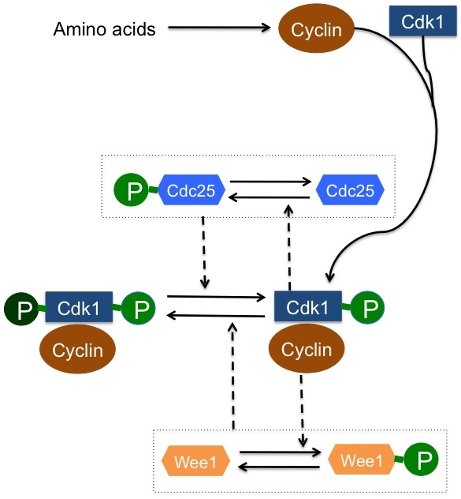
Accumulating MPF
From Amino Acids to MPF
Accumulating MPF
Notes:
Accumulating MPF– two pieces: first, formation of the cyclin-cdk1 complex; then, a complex set of feedbacks lock the complex into its singly-phosphorylated form.
We take the second one (Accumulating MPF) first
Why does it suggest that PreMPF peaks first?
Note that Cdc25 and Wee1 seem to be fighting each other: Cdc25 (when phosphorylated) removes a phosphate group from PreMPF but Wee1 (when dephosphorylated) adds a phosphate group to MPF
However -- experiments indicated that MPF phosphorylates both Cdc25 and Wee1. What does this mean about their activity? Where do you expect things to go?

Slide 16
Discussion
Assume that cyclin is being created and none is being degraded
Assume that Wee1 and Cdc25 are initially unphosphorylated
Each group: prepare a description of these mechanisms
What happens as the cyclin is created?
What happens to Wee1 and Cdc25 as MPF and PreMPF are created?
Does this wiring diagram explain the graphs?

Slide 17
A model
1. Accumulating MPF
2. Degrading MPF
Diagram adapted from Sible and Tyson, Methods 41, 2007
Key:
Solid lines are reactions
Dotted lines represent catalytic influences
Notes:
Now we know what the first half of the model does
It turns out that accumulation of MPF triggers its own destruction – a negative feedback loop here.

Slide 18
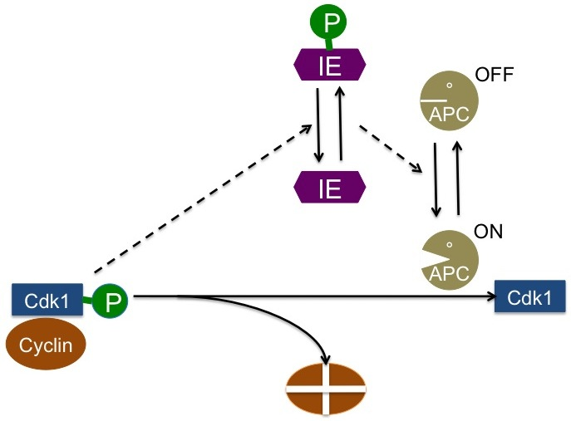
Degrading MPF
Notes:
IE is an “intermediate enzyme” (later found to be Fizzy/Cdc20) that activates the Anaphase Promoting Complex, which triggers progress during mitosis from metaphase to anaphase, by tagging the cyclin with ubiquitin, making it a target for degradation.
MPF phosphorylates an enzyme in the APC, which results in the activation of APC. Active APC degrades MPF back into Cdk1 and the amino acids that are used to build cyclin.

Slide 19
The players
Intermediate Enzyme (IE)
Later found to be Cdc20
Component of APC
Anaphase Promoting Complex (APC)
Tags proteins for destruction
Activating different components can target different proteins

Slide 20
Degrading MPF
Notes:
IE is an “intermediate enzyme” (later found to be Fizzy/Cdc20) that activates the Anaphase Promoting Complex, which triggers progress during mitosis from metaphase to anaphase, by tagging the cyclin with ubiquitin, making it a target for degradation.
MPF phosphorylates an enzyme in the APC, which results in the activation of APC. Active APC degrades MPF back into Cdk1 and the amino acids that are used to build cyclin.

Slide 21
Discussion
Assume that the amount of MPF increases from nothing to a large value
Assume that IE is initially unphosphorylated
Each group: prepare a description of how the states and concentrations of each protein change

Slide 22
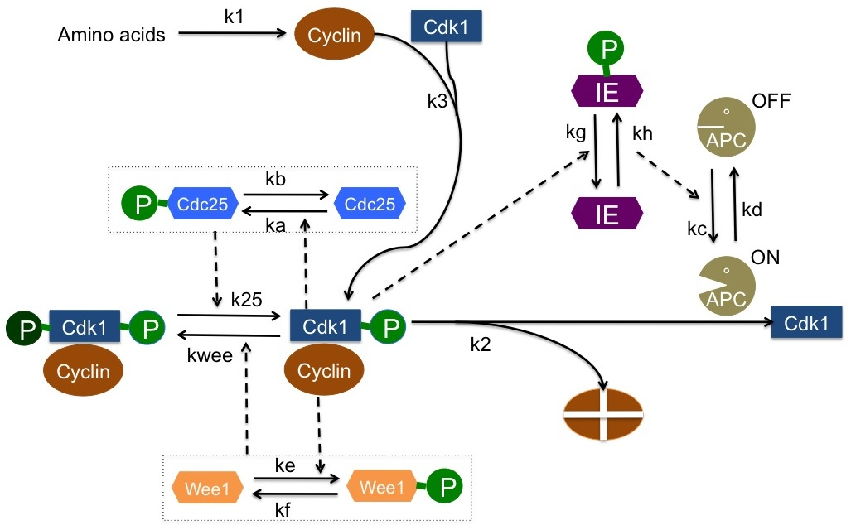
The reaction rates
Notes:
Reaction rates are given on the diagram, but what do they mean?
K1 and k3 are straightforward mass action kinetics
K2 has two values, depending on whether APC is on or off – we define two rules to deal with this
Ka, kb, kc, kd, ke, kf, kg, and kh are all catalytic reaction rates – we use the Sat function to compute the Michaelis-Menten rate for these reactions
K25 and kwee are rates for catalytic reactions, but there are two rates depending on the phosphorylation states of Cdc25 and Wee 1. We will use two rules each and an auxiliary computation.

Slide 23
Discussion
Can we say anything about the effects of the reaction rates?

