Slide 1
Differential Equations

Slide 2
Some questions ode’s can answer
Quick example
How to solve differential equations
Second example

Slide 3
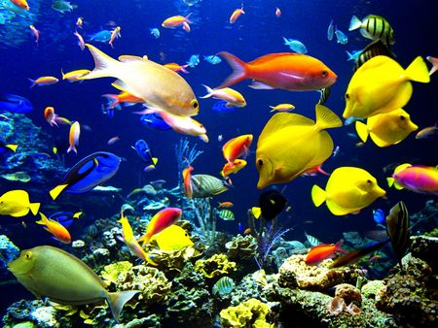
Some questions
How many tons of fish can fishermen harvest from a lake each year without endangering the fish population?

Slide 4
Some questions
How many cattle can graze on a 1,000,000 acre spread?

Slide 5
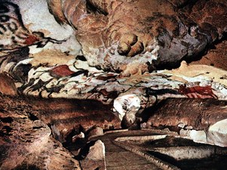
Some questions
How long ago did prehistoric humans paint on the walls of Lascaux, France?

Slide 6
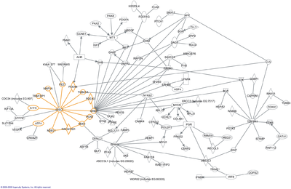
Some questions
How fast can proteins combine?
What happens to populations of different proteins as they combine with each other?

Slide 7
What is a differential equation?
The formal definition is that it is an equation involving a function and one or more of its derivatives.

Slide 8
First question
How many tons of fish can fishermen harvest from a lake each year without endangering the fish population?

Slide 9
Let’s Go Fishing
Balance law:
Net rate of change = rate in – rate out
For the fish:
Net change = birth rate – (death rate + harvest rate)
X
X

Slide 10
A difference equation
Difference equation:
Fish(t+1) = Fish(t) – death_rate*Fish(t) – harvest_rate*Fish(t) + birth_rate*Fish(t)
Use λ for birth rate
Use μ for death rate + harvest rate
F(t) = F(t-1) + λF(t-1) – μF(t-1)

Slide 11
A differential equation
F(t+Δt) = F(t) + λF(t) Δt – μF(t) Δt
Letting Δt go to 0:
F(t+dt)-F(t) = (λ – μ)F(t)dt
d/dt F(t) = (λ – μ)F(t)

Slide 12
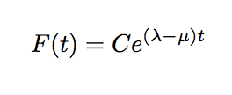
Use Maple to solve this
dsolve(ode)
Exercise: Check the answer

Slide 13
Goals…
We will NOT be solving differential equations
The lecture is to help you model a physical situation with differential equations

Slide 14
Overview
A differential equation is an equation involving a function and one or more of its derivatives
It represents how the function changes with respect to something – time or space.
Real-world differential equations are hard to solve
We use numerical approximations
Maple contains many approximation algorithms

Slide 15
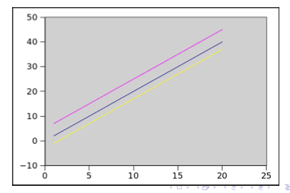
Starting from the solution
A differential equation: f’(t) = C
A few solutions to f’(t)=2:
f(t)
t

Slide 16
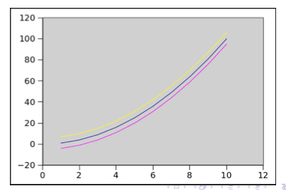
Starting from the solution
A differential equation: f’(t) = Ct
A few solutions to f’(t) = 2t:
f(t)
t
Notes:
parabola

Slide 17
Which solution?
How do we know which solution is correct?
If we know any point on the solution, we can decide which is correct!
Only one point is necessary for this type of problem
Initial condition!!
Exercise: If f’(t)=2t and (t₀,f(t₀)) = (4,22), what is f(t)?
Answer: f(t) = x²+6

Slide 18
Second question
How many cattle can graze on a 1,000,000 acre spread?

Slide 19
Also a population problem
Population growth with a maximum carrying capacity:
Carrying capacity of 1,000,000 acres for grazing

Slide 20
Modeling Population Growth
P(t) is the population at time t
r is the growth rate of P (births-deaths)
K is the environmental carrying capacity
Exercise: Use Maple to make a graph of the function f(x) = rx(1-x/K)

Slide 21
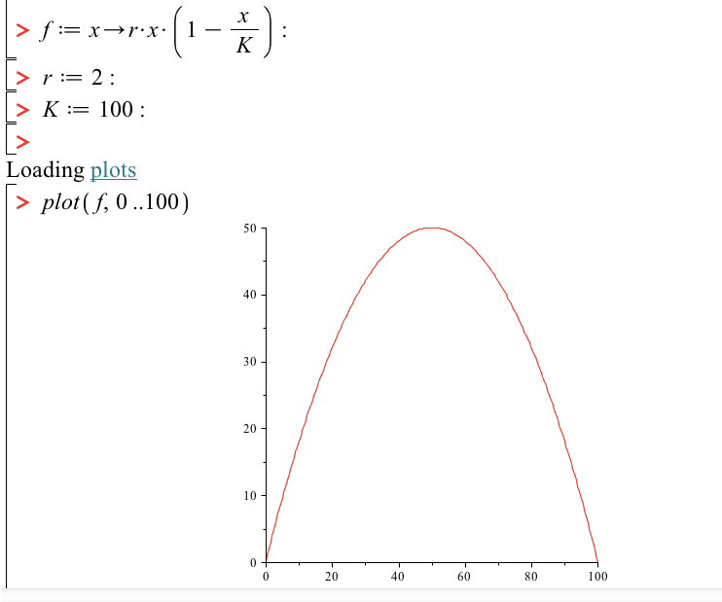
Modeling Population Growth

Slide 22
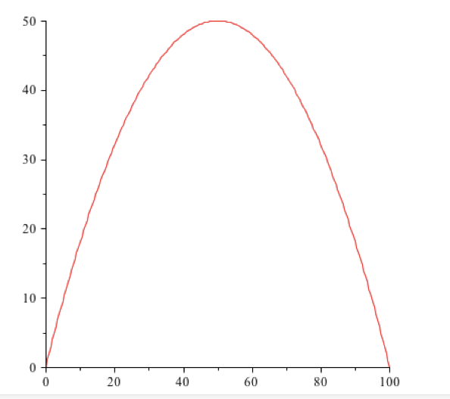
Modeling Population Growth
Can you guess what the curve for P(t) looks like?

Slide 23
Modeling Population Growth
Can you guess what the curve for P(t) looks like?
At first, it grows slowly (why?)

Slide 24
Modeling Population Growth
Can you guess what the curve for P(t) looks like?
At first, it grows slowly (why?)
Then it grows fast (why?)

Slide 25
Modeling Population Growth
Can you guess what the curve for P(t) looks like?
At first, it grows slowly (why?)
Then it grows fast (why?)
Then it must slow down (why?)

Slide 26
A Sigmoid Curve
The derivative:
The curve:

Slide 27
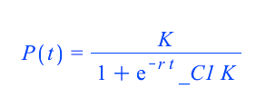
The Logistic Function
Exercise: use Maple to solve the ode
First symbolically

Slide 28
The Logistic Function
May also be written
or
What is the limit as t->∞ of P(t)?
P₀ is the initial condition (consider t=0)

Slide 29
The Logistic Function
Exercise:
Solve for
growth rate=2 (births-deaths)
Carrying capacity=50
Initial population=2 (with an initial condition, we can get the exact function)
Plot the solution against t

Slide 30
Third question
How long ago did prehistoric humans paint on the walls of Lascaux, France?

Slide 31
Carbon dating
The ratio of carbon-14 to carbon-12 is constant
Living things are continually incorporating new carbon, so their ratio is the same
When they die, the carbon-14 begins to decay (and no new carbon is incorporated)
Therefore – we can estimate dates using the half-life of carbon-14

Slide 32
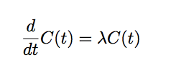
Carbon-14 dating
The differential equation is:
The solution is:
Notes:
Half-life is how long it takes for half to go away: C(t

Slide 33
Using half-life
The half-life is how long it takes half of the substance to go away
Let t₀ be the start time
Let t_{1/2} be the time when half has gone away
C(t_{1/2}) = ½*C(t₀) = ½*C₀

Slide 34
Biochemical Reactions
How do we track the behavior over time of interacting chemicals in a solution?
A set of differential equations, based on the reaction rules!!

Slide 35
Exercise
Let's look at the growth of bacteria.
Bacteria reproduce using binary fission and double in number in each time frame assuming they have enough food. So the change in the number of bacteria is dependent on the number of bacteria already present.

Slide 36
Exercise
Assume our example bacteria doubles every ten minutes and has plenty to consume.
Starting with one bacteria, use Maple to plot the number of bacteria every ten minutes for two hours. How many bacteria are there after two hours?

Slide 37
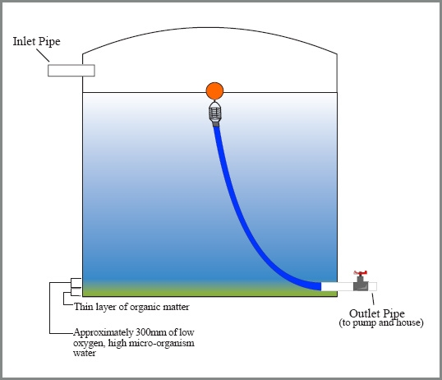
Exercise
Chemical
Solution
Chemical
Solution

Slide 38
Exercise
A substance is dissolved in a liquid in a tank
Liquid enters and leaves the tank
The entering liquid may have higher, lower, or the same concentration as the liquid already in the tank
The liquid in the tank is “well-mixed”

Slide 39
Final questions
How fast can proteins combine?
What happens to populations of different proteins as they combine with each other?

