Slide 1
Chemical Kinetics
Nancy Griffeth
January 8, 2014
Funding for this workshop was provided by the program “Computational Modeling and Analysis of Complex Systems,” an NSF Expedition in Computing (Award Number 0926200).

Slide 2
What is chemical kinetics
The study of the rates at which chemical reactions take place
Factors to consider
Concentration
Temperature
Presence of catalysts

Slide 3
Reaction rates
The rate of a chemical reaction is a measure of how the concentration (or pressure) of the involved substances changes with time.

Slide 4
Chemical Reactions
2Na + Cl₂ → 2 NaC
table salt
S + O₂ → SO₂
sulfur dioxide
4 Fe + 3 O₂ → 2 Fe₂O₃
iron rusting
CO₂ + H₂O → H₂CO₃
carbon dioxide dissolving and reacting with water to form carbonic acid

Slide 5
Biochemical Reactions
Aerobic Respiration
Glucose+Oxygen → CarbonDioxide+Water +Energy
C₆H₁₂O₆+ 6O₂ → 6CO₂ + 6H₂O + energy
Anaerobic Respiration
C₆H₁₂O₆ → 2C₂H₅OH+2CO₂ + Energy
Glucose → Ethanol+CarbonDioxide+Energy
Metabolism of ethanol
Ethanol → Acetaldehyde
CH₃CH₂OH + NAD⁺ → CH₃CH=O + NADH + H⁺

Slide 6
Rates Part I: The Law of Mass Action
Rate:
.039/sec
Reaction:
CO₂ + H₂O → H₂CO₃
Define: [A] = concentration of A (e.g., moles per liter)
d[H₂CO₃]
= k₊[CO₂][H₂O]
dt
= .039[CO₂][H₂O]
Notes:
Carbonic acid

Slide 7
The Law of Mass Action
Forward Rate:
.039/sec
CO₂ + H₂O → H₂CO₃
Reaction:
←
Backward Rate:
23/sec
d[H₂CO₃]
= k₊[CO₂][H₂O] - k₋[H₂CO₃]
dt
= .039[CO₂][H₂O] - 23[H₂CO₃]
Notes:
At equilibrium: The instantaneous forward rate is exactly equal to the instantaneous reverse rate

Slide 8
Reaction Equilibrium
At equilibrium, the instantaneous forward rate equals the instantaneous reverse rate.
k₊[CO₂][H₂O] - k₋[H₂CO₃] = 0
[CO₂][H₂O] k₋
[H₂CO₃] k₊
K = 23/.039 ~ 590
=
= K
Since the equilibrium constant is large, we can predict that very little carbonic acid forms.

Slide 9
Deriving Equilibrium Values
In the absence of other reactions involving CO₂ and H₂CO₃,
the quantity [CO₂]+[H₂CO₃] = A₀ is conserved.
We can use this to compute various things:
[H₂CO₃]_{eq} = A₀
[H₂O]_{eq}
K + [H₂O]_{eq}
K
K + [H₂O]_{eq}
[CO₂]_{eq} = A₀

Slide 10
Forming Dimers
M is a monomer
D is a dimer
M + M → D
k₊
k₋
←
d[M]
dt
= 2k₋[D] - 2k₊[M][M]

Slide 11
Forming Dimers - Exercise
d[M]
dt
= 2k₋[D] - 2k₊[M]²
d[D]
dt
= -k₋[D] + k₊[M]²
d[D]
dt
d[M]
dt
= -1/2
[M] + 2[D]
is conserved
Notes:
2[D]: every time a dimer breaks up, you get two M’s -2[M]^2: each dimer requires two M’s to make it up
(2) The rate of change in D’s goes in the opposite direction from the rate of change in M’s and is 1/2 as fast (because it takes two M’s to make a D)
(3) If no dimers are formed, this is [M]; if all [M]’s become D’s we have half as many molecules, all of which are D’s, so [M] + 0 = 0 + 2[D].

Slide 12
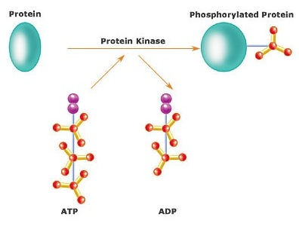
Organic Chemical Reactions Phosphorylation
Example of enzymatic action
Notes:
A particular reaction that is promoted by certain proteins called “Kinases.”
Protein kinase: a type of enzyme that transfers phosphate groups from high-energy donor molecules, such as ATP, to specific substrates.

Slide 13
Enzyme Kinetics
A kinase is an enzyme
Enzymes are catalysts that make reactions faster
Catalytic power
Specificity
Regulation
Can increase speeds up to 1 million times

Slide 14
Enzyme Kinetics
Enzymes don’t follow the law of mass action directly
By the law of mass action, the rate of S+E->P+E would increase linearly with increasing [S]
In enzymatic reactions, the rate increases less than linearly with the increase in S and reaches a maximum

Slide 15
Rate Laws: Enzymatic Action
Instead of
S+E P+E
the reaction creates a complex SE from the substrate and enzyme, followed by dissociation of the complex into the product and the enzyme.

Slide 16
Enzymatic Action
Assumption 1: The enzyme forms a complex with the substrate, from which the product is formed.
Exercise: What is the chemical formula?
k₁
k₂
E+S ES E+P
k₋₁
k₋₂

Slide 17
Enzymatic Action
Assumption 2: The product doesn’t react with the enzyme.
Exercise: How does this change the formula?
k₁
k₂
E+S ES E+P
(k₋₂ = 0)
k₋₁

Slide 18
Rate Laws: Enzymatic Action
Let s=[S] (substrate),
e=[E] (enzyme),
c=[ES] (complex),
p=[P] (product

Slide 19
Exercises
Rate of change of substrate:
Rate of change of complex:
Rate of change of enzyme:
Rate of change of product:
ds
dt
= -k₁se + k₋₁c
dc
dt
= k₁se - k₋₁c - k₂c
de
dt
= -k₁se + k₂c + k₋₁c
dp
dt
= k₂c

Slide 20
Equilibrium Approximation
p = 1/2 k₂ c² + p₀
Conserved quantity: + = 0, so c + e = e₀
dc
dt
de
dt

Slide 21
Equilibrium Approximation
Assumption 3: S+E → C reaches instantaneous equilibrium: k₁se = k₋₁c
From e+c=e₀ (e = e₀ - c): k₁se₀ - k₁sc = k₋₁c k₁se₀ = k₋₁c + k₁sc
k₁
←
k₋₁
k₁se₀
k₋₁ + k₁s
e₀s
K₁ + s
c = =
k₋₁
k₁
where K₁ =

Slide 22
Equilibrium Approximation
Rate of formation of product:
Versus Law of Mass Action:
dp
dt
k₂e₀s
K₁ + s
V_{max}s
K₁ + s
V = = k₂c = =
S + E → P + E
dp
dt
V = = k₂se₀ = V_{max}s

Slide 23
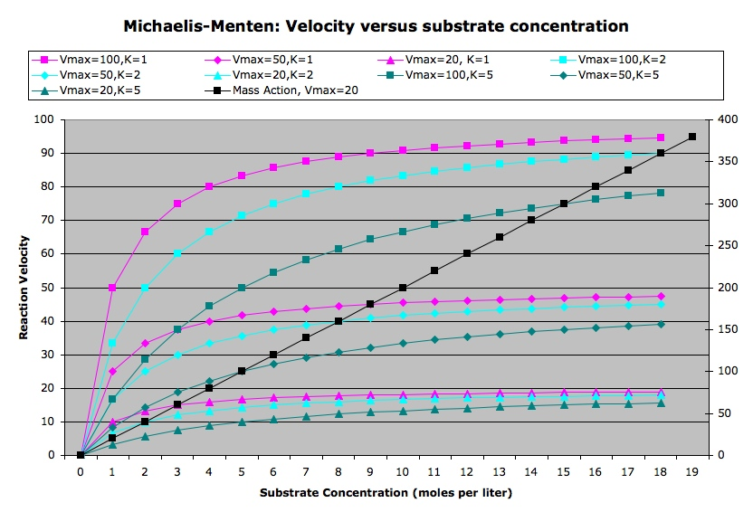
Equilibrium Approximation versus Mass Action

Slide 24
Quasi-steady State Approximation
Assumption 3: The concentration of the complex changes much more slowly than the concentrations of the substrate and the product
Exercise: How would you model this?
dc
dt
= k₁se - k₋₁c - k₂c ≈ 0

Slide 25
Quasi-steady State Approximation
Assumption 4: The enzyme concentration doesn’t change over time.
Exercise: How would you model this? e₀ = e + c is a constant

Slide 26
Exercise
Using
e₀ = e + c is a constant and
compute (the rate of change of the
concentration of the product) as a function
of s (the concentration of the substrate).
dc
dt
= k₁se - k₋₁c - k₂c ≈ 0
dp
dt

Slide 27
Answer to Exercise
dp
dt
s
= k₂ e₀
k₂ + k₋₁
k₁
+ s
k₂ + k₋₁
k₁
Let K_{M} = and v_{max} = k₂ e₀
dp
dt
s
K_{M} + s
Then = v_{max}

Slide 28
Consequences
What can we say about the reaction if:
s << K_{M}?
s ≈ K_{M}?
s >> K_{M}?
Hint: Look at
s
K_{M} + s

