Slide 1
Models and Modeling

Slide 2
Models

Slide 3
Models We Will Use
Wiring diagrams for Chemical Reactions
Mathematical Models (Differential Equations)
Computer Models (RuleBender)

Slide 4
What good are models?
Models are abstract descriptions of the world.
They are easier to work with and think about than real objects.
Notes:
What we need for a thought experiment is a model and some thoughts about its consequences. For example….

Slide 5
Thought Experiments
A proposal for an experiment that would
test or illuminate a hypothesis or theory.
Based on a model.
Notes:
Galileo

Slide 6
Falling Objects
Aristotle: The heavier an object, the faster it falls.
Galileo: All objects will fall at the same speed in a vacuum.

Slide 7
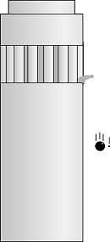
Falling Objects
Salviati. If then we take two bodies
whose natural speeds are different,
it is clear that on uniting the two,
the more rapid one will be partly
retarded by the slower, and the slower
will be somewhat hastened by the
swifter. Do you not agree with me
in this opinion?
Notes:
From Galileo’s Mathematical Discourses and Demonstrations
Did Galileo actually drop the cannon balls from the Tower of Pisa?

Slide 8
Falling Objects
Simplicio. You are unquestionably right.

Slide 9
Falling Objects
Salviati. But if this is true, and if a large
stone moves with a speed of, say, eight
while a smaller moves with a speed of four,
then when they are united, the system
will move with a speed less than eight;
but the two stones when tied together
make a stone larger than that which
before moved with a speed of eight.

Slide 10
Falling Objects
Salviati. Hence the heavier body moves
with less speed than the lighter; an effect
which is contrary to your supposition.
Thus you see how, from your assumption
that the heavier body moves more rapidly
than the lighter one, I infer that the
heavier body moves more slowly.

Slide 11
What other thought experiments do you know?
Schrodinger’s Cat
Maxwell’s Demon
Others?

Slide 12
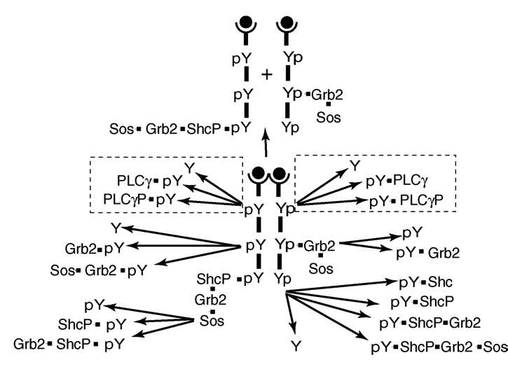
Recap: Modeling Signaling Pathways
Black box
Linear pathway
Branched pathway / complexes
Combinatorial complexity
EGF
EGFR
GRB2
SOS
RAS
RAF
MAPK
MYC

Slide 13
Computers and Models
Computers let us put models on steroids!!
We can “think” about the consequences
of the model by running a computer
simulation, by using the computer
to solve equations, or by using it to
study model properties.

